Slide 1
Climate system and climate change
Čedo Branković
cedo.brankovic@cirus.dhz.hr

Slide 2
Outline
1. Observed climate of Croatia
2. Climate system
3. Climate variability and climate change
4. Observed climate change
5. Future climate change

Slide 3
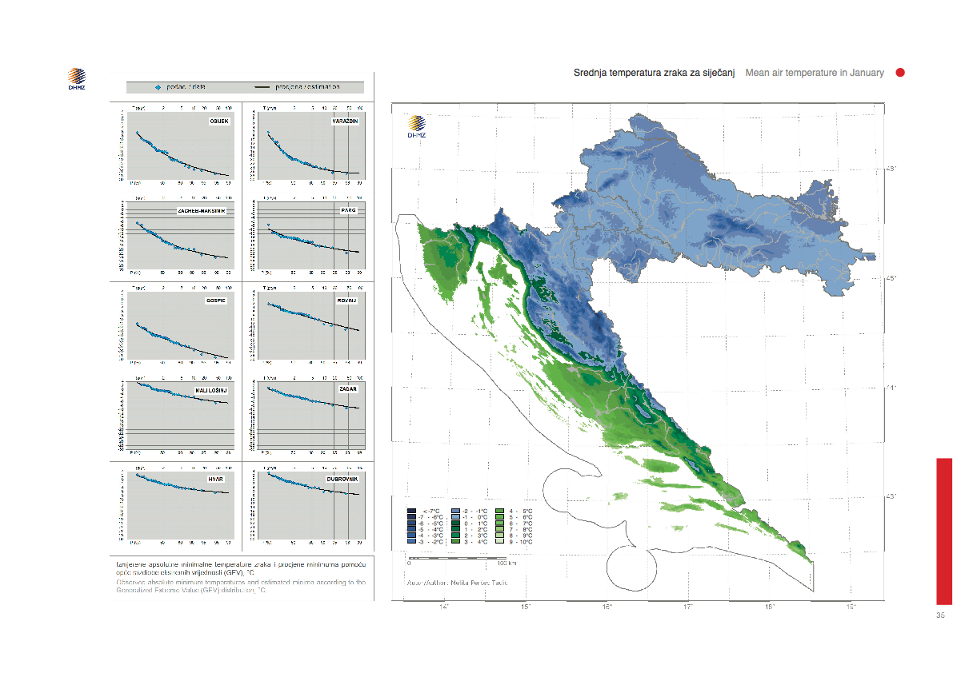
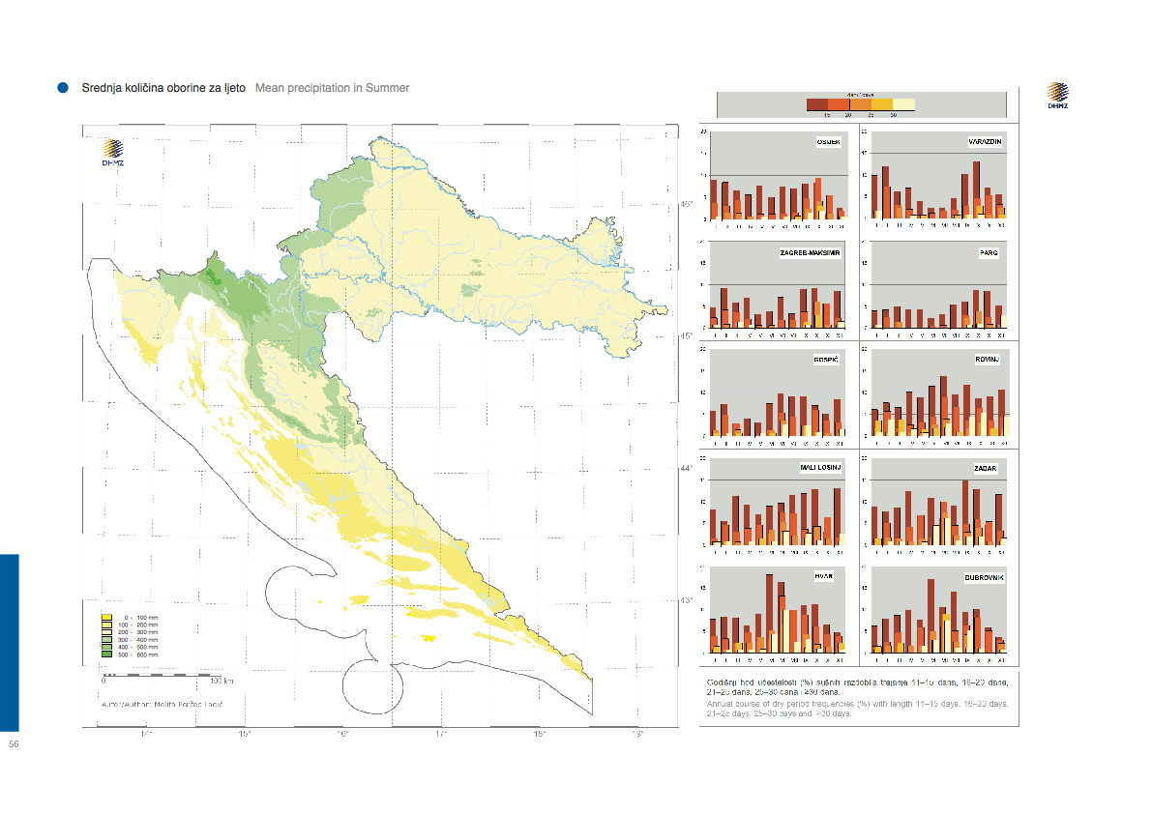
Observed climate of Croatia
Mean air temperature
January 1961-1990
Mean precipitation
July 1961-1990
Source: Zaninović et al. (2008) Climate atlas of Croatia

Slide 4
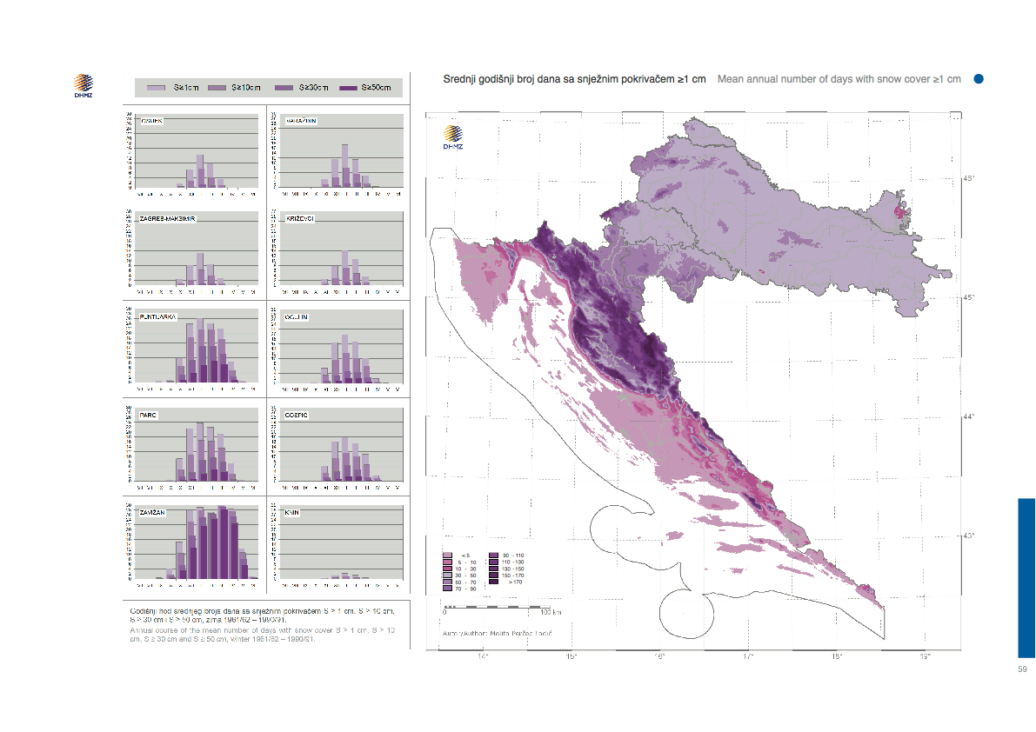
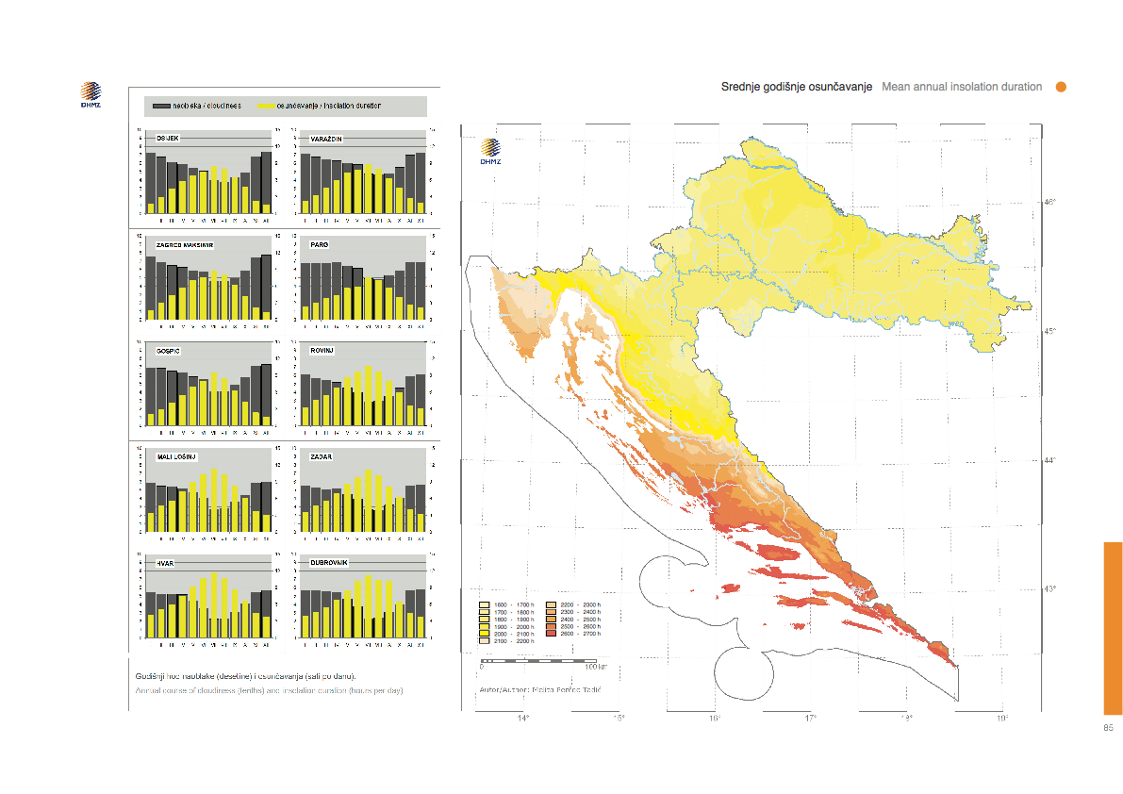
Observed climate of Croatia
Mean annual number of days with snow cover ≥ 1 cm
Mean annual insolation duration (hours)
Source: Zaninović et al. (2008) Climate atlas of Croatia

Slide 5
What is climate?
* Climate of an area for a given period is defined by expected values of
meteorological variables
* Climate is the "average weather" - a statistical description of weather,
including variability and extremes
* Climate is only external manifestation of climate processes, dynamics and
interactions of components of climate system
* Components of climate system are atmosphere, hydrosphere (oceans, seas,
lakes), cryosphere (ice cover, sea ice), land surface, biosphere
(vegetation)
* Climate of an area is affected by its latitude, elevation, proximity to
large water bodies (oceans, seas, lakes), topography, prevailing winds, ...
* Climate variables (elements): solar radiation, air temperature, air
pressure, wind direction and speed, humidity, precipitation, evaporation,
snow cover, ...

Slide 6
Climate system
* Earth’s climate is a solar powered system
* Atmosphere and oceans redistribute solar heating from the equator
towards the poles - Earth’s heat engine
* Earth’s heat engine also simultaneously radiates heat from the surface
and lower atmosphere back to space
* The net flow of energy into and out of the Earth system is Earth’s energy
budget

Slide 7
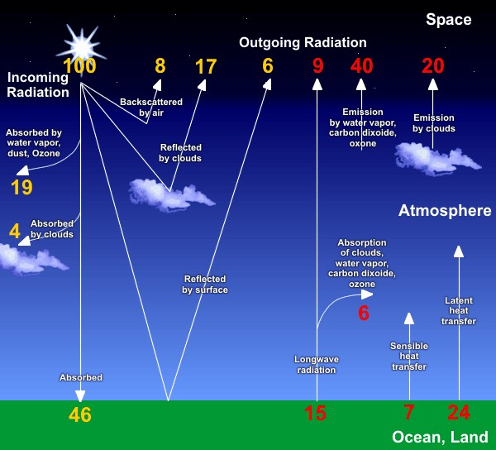
Earth’s energy budget
Source: Internet

Slide 8
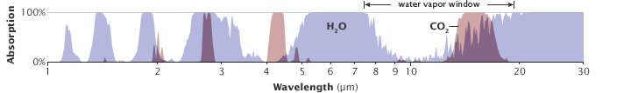
Earth’s energy budget
* Absorbtion by atmospheric gases
* The role of water vapour and CO₂
Source: earthobservatory.nasa.gov

Slide 9
Climate variability and climate change
* Climatological normal
* long-term (usually 30-year) average of a weather variable
* Climate variability
* fluctuations above or below climatological normal on short time scales
* denotes deviations (anomalies) of climatic statistics over a given period
of time
* due to natural internal processes within the climate system (internal
variability), or to variations in natural or anthropogenic external factors
(external variability)
* Climate change
* long-term continuous and significant change to average weather
conditions (or to statistical distribution of weather events)
* on time scales of decades to millions of years
Key terms

Slide 10
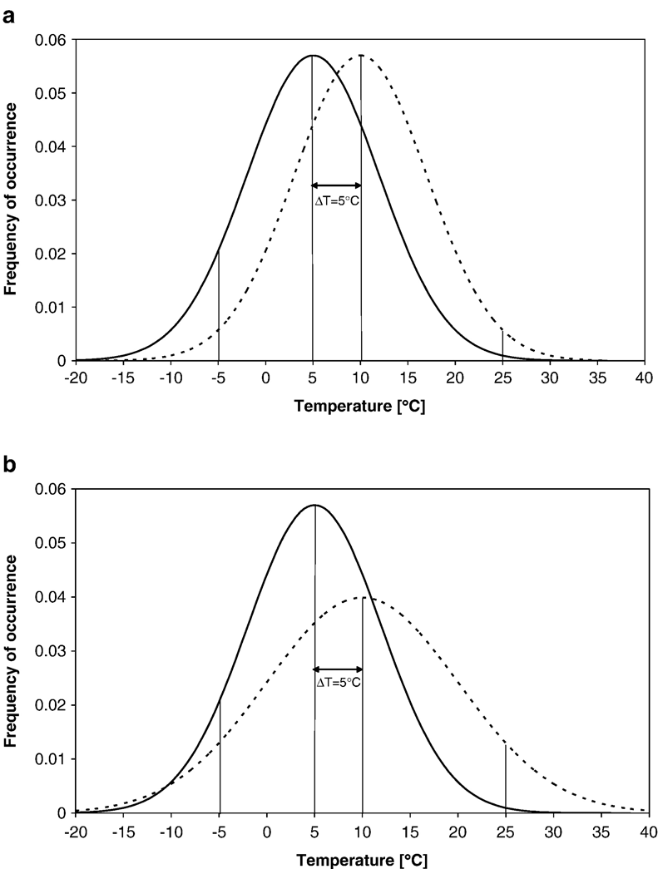
Climate variability and climate change
* Frequency of occurrence
Climate A
Shift in the frequency of occurrence with same variability
Climate B
Climate A
Shift in the frequency of occurrence with increased variability
Climate B
Source: Beniston and Goyette, Global and Planetary Change (2007)

Slide 11
Causes of climate change
* Change in Earth’s energy balance
* Natural causes of climate change
* variation in the Sun’s energy reaching Earth
* changes in Earth’s orbit
* volcanic eruptions (aerosols)
* Anthropogenic causes of climate change
* deforestation
* land use
* burning of fossil fuels
They cause the increase in CO₂ levels, aerosols, ozone depletion

Slide 12
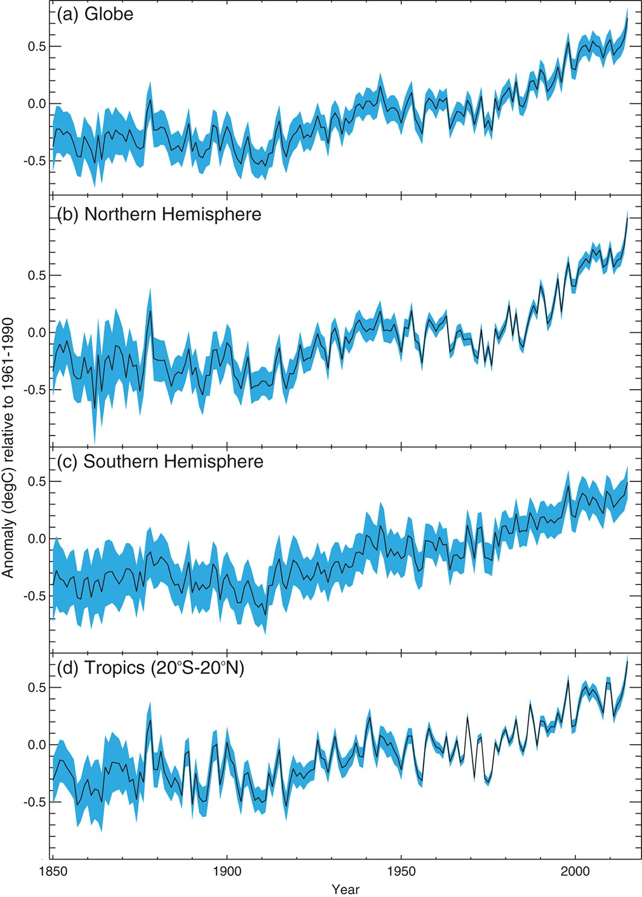
Observed climate change
* Climate variability and climate change contribute to modern climate
* Climate variability is "superimposed" on the climate change long-term
evolution
* Detection of climate change over a short time period may be difficult
Best estimate of observed annual temperature anomalies (relative to the period 1961-1990)
Climate change
Source: Kennedy et al.
(Weather, August 2016)
Climate variability

Slide 13
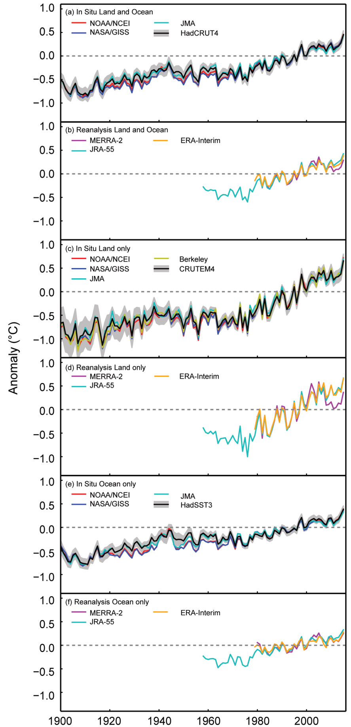



Observed climate change
Land and
ocean
Observed temperature
anomalies relative to the
period 1981-2010
Land only
Ocean only
Source: State of the climate (BAMS, August 2016)

Slide 14
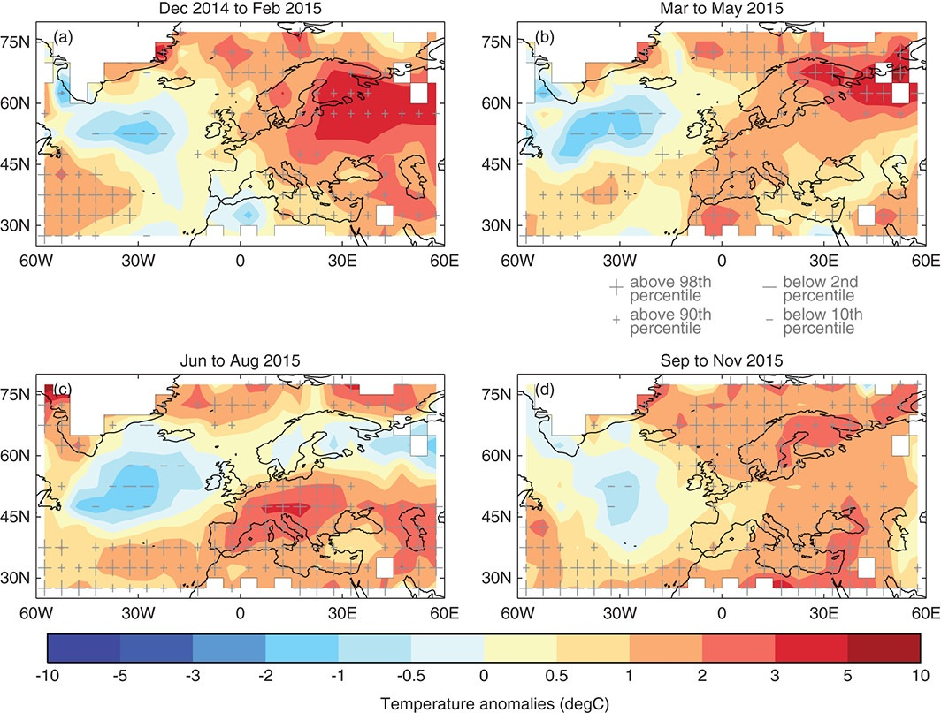
Observed climate change
Temperature anomalies in 2015
relative to the period 1961-1990
Winter
Spring
Summer
Autumn
Source: Kennedy et al.
(Weather, August 2016)

Slide 15
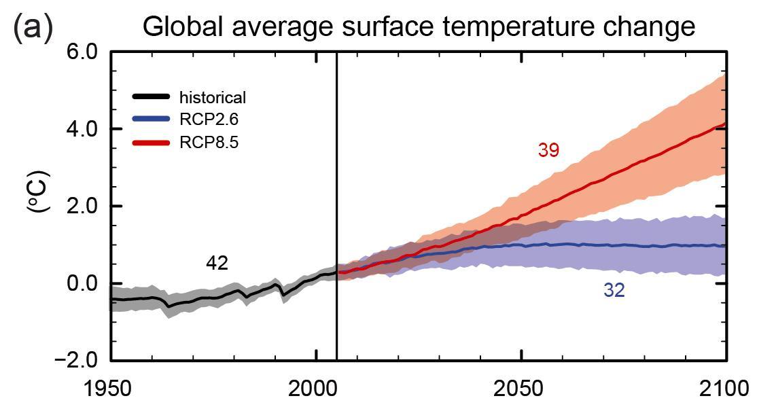
Future climate change
Modelling climate change = Modelling Earth system
Source: IPCC 2013

Slide 16
Future climate change
* Uncertainties
Sources of uncertainities:
* Natural variablity of climate system
* chaotic interaction among components of climate system
* natural fluctuation can “mask” future climate changes
* Limits of scientific knowledge
* limited understanding of climate system
* inadequacy (imperfections) of climate models
* uncertainties in initial conditions
* Socio-economic uncertainty
* depends on Earth’s population, industrial and technological development,
... (scenario uncertainties)

Slide 17
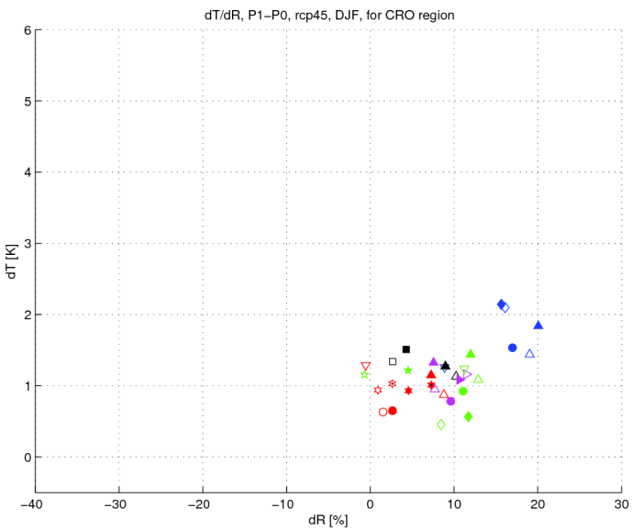
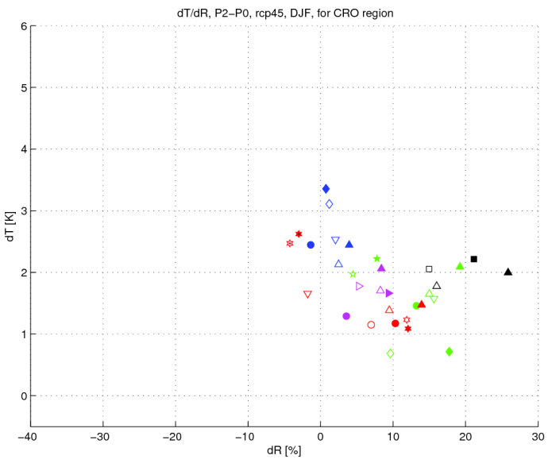
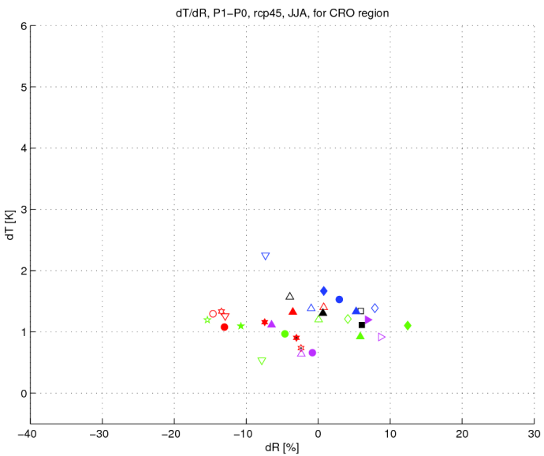
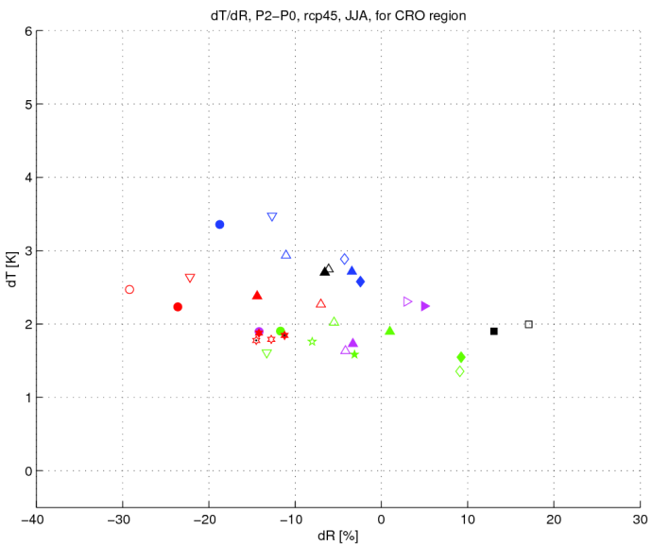
Future climate change over Croatia (I. Güttler, L. Srnec, T. Stilinović)
CORDEX + RegCM (DHMZ) simulations on VELEbit supercomputer at SRCE
P1 – P0
P2 – P0
P0=1971-2000
P1=2011-2040
Winter
P2=2041-2070
‹— change in temp —›
∆
Summer
‹— change in precip —›

