Slide 1
The experience of Italy in the design and implementation of adaptation to climate change
Dr. Sara Venturini
Workshop “Sharing experiences of EU countries in the development and implementation of strategies to adapt to climate change”
Zagreb, 8 – 9 September 2016

Slide 2
OVERVIEW
Key drivers for policy action in Italy
      Alignment to the EU guidance
      The National Adaptation Strategy project
      Adoption process
      Conclusions

Slide 3
KEY QUESTIONS
Overview of process/steps of how the national Strategy on climate change adaptation has been developed,
Which sectors were taken into consideration (vulnerable sectors) and how they were integrated into a specific answer to climate change?
How to arrive from outputs of climate models for the future climate to adaptation measures?
What was the timeframe used for the Strategy preparation (i.e., 2030, 2040, 2050,…) and how used timeframes were reflected towards suggested adaptation measures? How the priority measures were defined – having in mind Action plan (for example, were there only one category of measures, e.g. short term measures with obligation for re-assessment of measures every 5 years, or, Action Plan immediately have defined short term, medium and long term measures?)
What kind of consideration was given to Strategy policies from other sectors? How they were integrated into Strategy for CC adaptation? How difficult was to establish connection among different Strategies in case they have different time horizons and measures?

Slide 4
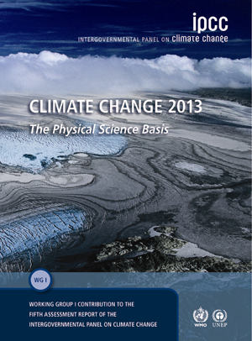



KEY DRIVERS FOR POLICY ACTION IN ITALY
Increasing concern by national institutions (2002 CIPE “National strategy for sustainable development” highlights the need to adapt; 2007 National Conference on Climate Change and “Manifesto for Climate” - identified top priority sectors and 13 priority actions for sustainable adaptation by the government)
Emerging scientific knowledge (IPCC Fifth Assessment Report - WGI, EEA thematic reports on CCIVA, EU projects and national project outcomes published in 2012)
EU Adaptation Strategy package (Strategy document; Guidelines on developing adaptation policies 2013)
Notes:
2012
“Urban adaptation to climate change in Europe - Challenges and opportunities for cities together with supportive national and European policies”
EEA
2012
“Climate change, impacts and vulnerability in Europe,
An indicator-based report”
EEA
2013
“Adaptation in Europe”
EEA
2013
“Climate Change 2013: The Physical Science Basis”
IPCC

Slide 5
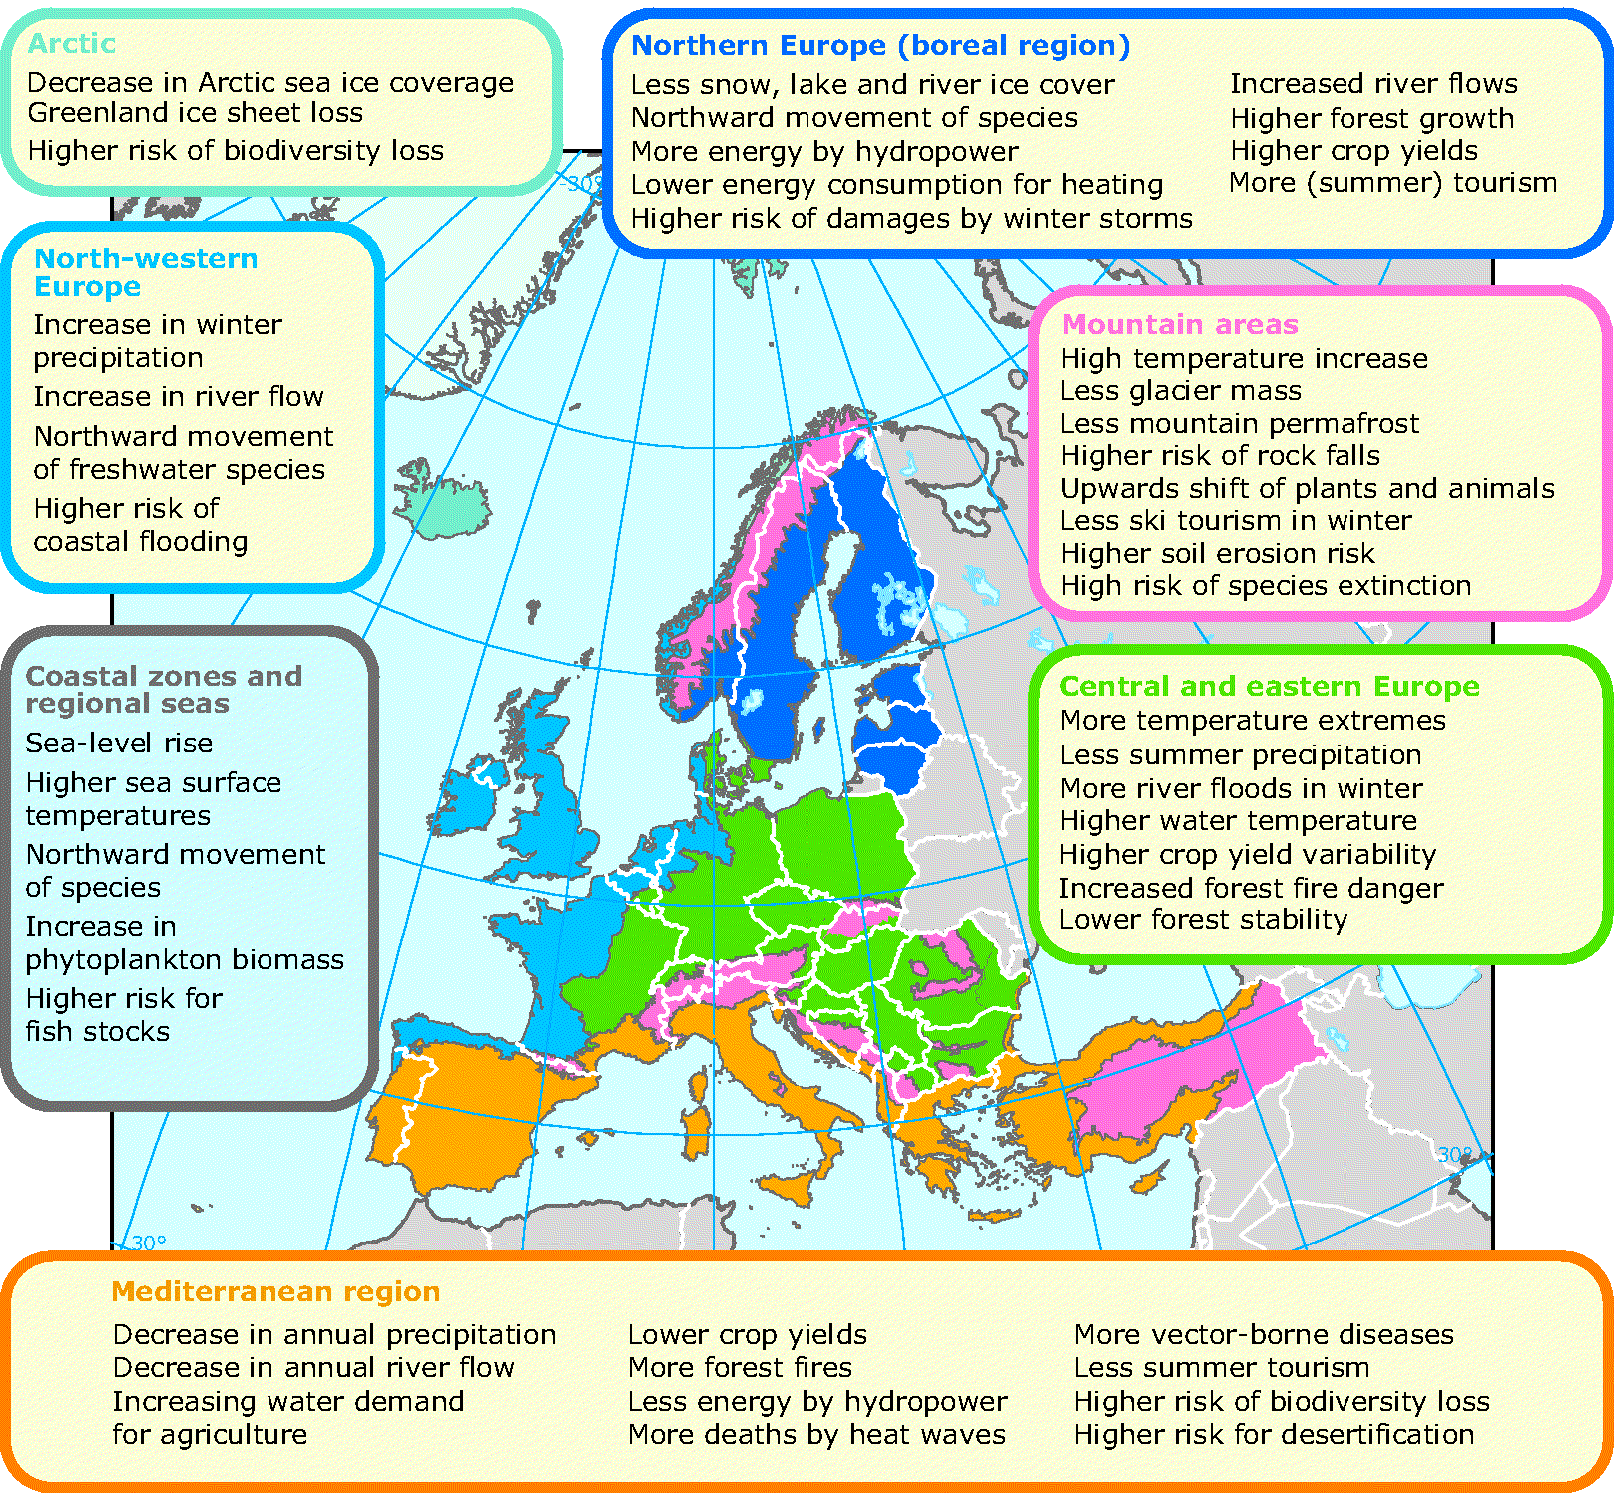
KEY DRIVERS FOR POLICY ACTION IN ITALY: SCIENTIFIC EVIDENCE
The Mediterranean Region is a hot spot for climate change
Southern Europe and Mediterranean Basin: combined effect of high temperature increases and reduced precipitation in areas already coping with water scarcity
Mountain areas (in particular the Alps): temperatures increase rapidly leading to widespread melting of snow and ice changing river flows
Coastal zones: sea level rise combined with increased risks for storms.
Source: Climate change, impacts and vulnerability in Europe, An indicator-based report EEA (2012)
Source: The European environment — state and outlook 2010 (EEA 2010)
Notes:
Italy is located in one of most vulnerable areas in Europe. As a Mediterranean country, Italy expects particularly negative impacts over the next decades (mainly associated to exceptional T rise, increased frequency of extreme events and reduced annual precipitation and river flow) that will increase its vulnerability

Slide 6

KEY DRIVERS FOR POLICY ACTION IN ITALY: POLICY GUIDANCE FROM EU
EU Guidelines on developing adaptation policies
EU Climate-ADAPT:
Adaptation Support Tool
Step 1. Preparing the ground for adaptation
Step 2. Assessing risks and vulnerabilities to climate change
Step 3. Identifying adaptation options
Step 4. Assessing adaptation option
                Prepare a strategy document and get political approval
Step 5- Implementation
  Develop an action plan
Step 6. Monitoring and evaluation
Policy cycle for users (6 steps)
Based on UKCIP Adaptation Wizard
Notes:
The concept of the Italian NAS was defined around October 2011 and adopted in July 2012
The EU NAS Guidance was released on April 16th 2013
The Italian NAS fulfills Step 1 to 4 of EU NAS Guidance
Need for additional work to fulfill Step 5 – 6: implementation and monitoring

Slide 7
ALIGNMENT TO THE EU GUIDANCE
National Adaptation Strategy (NAS):
    Involvement of stakeholders and decision-makers
    Analysis of possible mainstreaming of adaptation in the different sectoral policies
    Recommendations and guidelines to build up adaptive capacity in different sectors and at different spatial scales (national, regional and local) and to reduce societal costs
    Review after n years
    A National Adaptation platform
National Adaptation Plan (NAP):
    Implementation of NAS with governance provisions and funding allocation
    Evaluation of implementation (indicators)

Slide 8
TIMELINE
Development of Action Plan(s) and implementation of NAS?
Adaptation first included in national policy agenda
Initial discussion on NAS
SNAC Project: development of NAS in Italy
Adoption of Italian NAS
2002
2007
2011
2012
2013
2014
2015
2016
2017
EU Adaptation Strategy & guidelines for NAS
New science available: publication of relevant EEA reports and IPCC AR5

Slide 9


THE NATIONAL ADAPTATION STRATEGY PROJECT / MANAGEMENT
Nationally-funded project:
      “Elements for the elaboration of a National Adaptation Strategy to climate change”
Institutional Coordination: Italian Ministry for Environment Land and Sea
Technical Coordination: CMCC
Duration: 2 years (July 2012 - July 2014)
Notes:
The Italian Ministry for the Environment, Land and Sea (IMELS) had the primary responsibility for the establishment and preparation of the National Adaptation Strategy. It was supported by CMCC.
Budget was fairly small (under 50,000 K)

Slide 10
THE NATIONAL ADAPTATION STRATEGY PROJECT / OBJECTIVES
Key project aims:
Involvement of all national stakeholders
Assessment of CCIVA at national level
Provision of recommendations and guidelines to build adaptive capacity in different sectors and scales in order to implement cost-effective adaptation measures

Slide 11
      THE NATIONAL ADAPTATION STRATEGY PROJECT / APPROACH
TOP DOWN
Technical Panel – about 100 national scientists and sectoral experts
Interministerial Panel – line Ministries and institutional stakeholders (Dept. of Civil Protection,
Union of Italian Provinces, National Association of Italian Municipalities, Italian Committee of the Regions)
BOTTOM-UP
Participatory process – involvement of national stakeholders at all levels (civil society, scientific community, private sector…)
Notes:
An Institutional Panel, coordinated by the Ministry for Environment, Land and Sea, was established in order to contribute to the elaboration of the National Strategy. The Panel involves:
Ministry of Economic Development
Ministry of Agricultural and Forestry Policies
Ministry of Infrastructures and Transport
Ministry of Health
Ministry of Education, University and Research
Ministry of Cultural and Environmental heritages
Ministry of Regional affairs and Tourism and Sport
and institutional stakeholders such as:
Dept. of Civil Protection
Union of Italian Provinces
National Association of Italian Municipalities
Italian Committee of the Regions

Slide 12
      THE NATIONAL ADAPTATION STRATEGY PROJECT / PARTICIPATION
Stakeholders participation is key when developing and implementing adaptation to guarantee efficiency, commitment as well as social justice
(Bauer et al., 2012; Preston et al., 2011; Smith et al., 2009; Paavola, 2008; Beierle & Cayford, 2002; Reed, 2008)
Participatory process
Involvement of scientific community, and non-governmental stakeholders at all levels through:
On-line preparatory survey for public (October – November 2012); followed by further analysis with selected sample
Ad hoc Public Consultations for civil society, and sub-national administrations (Rome, 9-10 December 2013)
Public on-line review of the Strategy Document draft (30 October 2013 – 20 January 2014)
Notes:
Assumption: stakeholders participation is key when developing and implementing adaptation to guarantee efficiency, commitment as well as social justice
(Bauer et al., 2012; Preston et al., 2011; Smith et al., 2009; Paavola, 2008; Beierle & Cayford, 2002; Reed, 2008)

Slide 13
      THE NATIONAL ADAPTATION STRATEGY PROJECT / PARTICIPATION
Preparatory survey
Open questionnaire: 154 respondents, mostly from non-governmental areas (private sector 22%, scientific community 22%, NGOs etc 14%) all responding on personal behalf (73%)
Respondents mostly distributed along 4 sectors: Energy, Biodiversity, Forestry, Agriculture → these were contacted for further interview
Notes:
Assumption: stakeholders participation is key when developing and implementing adaptation to guarantee efficiency, commitment as well as social justice
(Bauer et al., 2012; Preston et al., 2011; Smith et al., 2009; Paavola, 2008; Beierle & Cayford, 2002; Reed, 2008)
Design of the questionnaire Q1 based on example of consultative processes on climate change and national documents (23 queries, mostly closed, multiple-choice or scale of liking; pop-up glossary)
Q1 on-line (1 Oct-15 Nov 2012) open to all and advertised by MATTM and CMCC
Identification and invitation of expert stakeholders on adaptation (professionals, academia, non-governmental org, business)
Elaboration of responses (spread-sheet, open-ended answers analysed through “clouds” to see most recurrent opinions)
Need to clarify some results of Q1: greatest share of respondents from only 4 sectors (Forestry, Biodiversity, Agriculture, Energy); unclear opinions on behavioral changes and sustainable use of resources; preference to mitigation-relevant options in closed questions
Design of targeted interviews Q2 (5 open-ended questions)
Selection of stakeholders from the 4 most represented sectors
Submission of oral/written interviews (June 2013)
Elaboration of results, synthesis of main and specific messages (17 full answers)

Slide 14
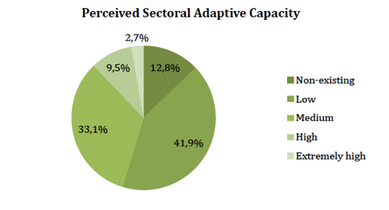
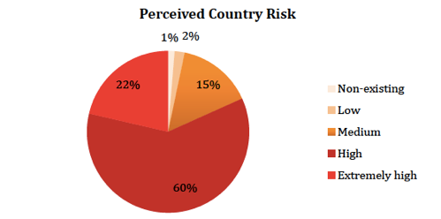
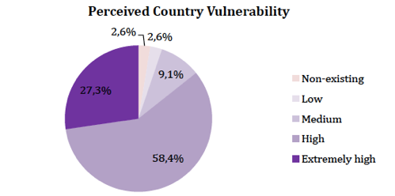
THE NATIONAL ADAPTATION STRATEGY PROJECT / PARTICIPATION
Preparatory survey
Results: citizens’ current perception of climate change
High or extremely high degree of risk related to impacts of climate change
Great vulnerability
Low sectoral adaptive capacity
No action (45%) or if so, fragmented
Notes:
Discussion of results
Respondents lack information about current adaptation action and existing means to reduce vulnerability in their sectors

Slide 15

THE NATIONAL ADAPTATION STRATEGY PROJECT / PARTICIPATION
Preparatory survey
Results: characteristics that the NAS should have and actions to take by the government
Objective: protection of territory including monitoring and safeguarding areas at risk of floods and landslide
Priorities: limiting land-use change, sustainable management of water and use of resources, reducing hydro-geological risk, improving energy efficiency
Focus on actions related to mitigation (increase renewable energy, efficiency of public transportation, car-pooling) and adaptation-mitigation synergies (improve energy efficiency in buildings, expand green areas...)
Legal nature of the adaptation policy: binding (82%)
Notes:
Discussion of results
Adaptation = protection of territory ... hydro-geological risk is the main concern of citizens
Adaptation = behavioral change ...intended as “environmental friendly” individual life-styles and promotion of adaptation through sustainable approaches (e.g. energy saving).
Most widely shared ideas on the meaning of adaptation were the need for sustainable consumption and behavioral changes, then risk prevention, improved land-use planning and higher energy efficiency
Mitigation-relevant options preferred as it is still the main issue at local and regional level (initial imperfect survey design?), but win-win strategies explicitly recognized by respondents of Q2
Focus on awareness-raising and education

Slide 16
      THE NATIONAL ADAPTATION STRATEGY PROJECT / KNOWLEDGE TOOLKIT
The Italian NAS package
In order to elaborate the NAS three main background documents have been published:
A national CCIVA assessment concerning the national sectors;
An analysis of European and national policy framework for adaptation;
Elements for a strategy document.

Slide 17
THE NATIONAL ADAPTATION STRATEGY PROJECT / KNOWLEDGE TOOLKIT
National CCIVA Assessment
Methodology: systmatic and coherent review of existing literature and experts appraisal, no new research
Definition and identification of vulnerable sectors
Assessment of past, present and future climate variability and change (regional projections from CIRCE project)
Assessment of present and expected impacts of climate change for each sector
Assessment of vulnerability/risk of each sector to the present and future climate
Assessment of adaptive capacity of each sector
Evaluation of already implemented adaptation measures in sectors
Tentative estimate of sectoral costs of inaction and adaptation - only for few sectors and not comparable
Notes:
The identification of impacts and vulnerabilities is mainly based on existing knowledge. The approach used to analyze impacts and vulnerabilities is systematic and coherent for all sectors investigated as well as based on literature review and experts appraisal. The report "State of the art on scientific knowledge of impacts vulnerabilities and adaptation of climate", produced by the Technical Panel of Experts in the context of the NAS process, illustrates in depth national sectors which are/will be affected by future impacts of climate change as well as vulnerabilities for Alps and Appennines and points out the following critical sector: water resources, soil (erosion, flood, desertification, landslide, sludge…), mountain and marine ecosystems and health.
No comprehensive national economic assessment on impacts and adaptation, only sectoral estimates (non comparable)
A first macro-economic assessment of climate change impacts for Italy by FEEM-ISPRA-CMCC (scope limited to 4 vulnerable areas):
Aggregated GDP loss of 0.12%-0.16% in the period 2001-2050 equal to a total loss of 20-30 bn Euros, considering a T increase of 0.93°C.
Sector most affected: tourism and the economy of the Alpine regions

Slide 18
THE NATIONAL ADAPTATION STRATEGY PROJECT / KNOWLEDGE TOOLKIT
Analysis of EU and national policy framework
  Analysis of the EU Adaptation Strategy (launched on April 29th, 2013)
  Overview of EU legislation for mainstreaming adaptation in EU sectoral policies (directives and regulations): water, agriculture, environment and biodiversity….
  Asessement of the degree of national implementation of Acquis communautaire for the different sectors of Italian NAS and remaining gap areas
  Analysis of NAS adopted in Europe with focus on governance settings and sectoral approaches (18 European countries with a NAS in 2014)

Slide 19
THE NATIONAL ADAPTATION STRATEGY PROJECT / KNOWLEDGE TOOLKIT
Elements of an Italian NAS
  General principles and objectives based on international guidance and lessons learnt from other EU countries. NAS provides a vision, reference framework for adaptation, as a basis for further action.
  A set of guidelines and measures to reduce risks, build resilience and take advantage of opportunities in various sectors, across multiple sectors and at different geographical (also transnational) scales and time horizons.

Slide 20
THE NATIONAL ADAPTATION STRATEGY PROJECT / STRATEGIC DOCUMENT
Italian National Adaptation Strategy
Contains and summarises the 3 background documents:
General objectives and principles for adaptation
European context on adaptation
Sectoral issues: key messages on existing impacts and vulnerability, and adaptation actions, (cost-benefit analysis)
Cross-sectoral issues
Conclusions and outlook
Glossary
Attachments:
  List of relevant EU legislation (directives, regulations)
  Summary of analysis of EU Adaptation Strategy and lessons learnt from other countries
  Long list of proposed adaptation actions
Available online (in IT only)

Slide 21
THE NATIONAL ADAPTATION STRATEGY PROJECT / STRATEGIC DOCUMENT
Sectors
Sectors where cost estimates are available are marked with *
WATER RESOURCES (quantity and quality)
DESERTIFICATION, SOIL DEGRADATION and DROUGHT
HYDRO-GEOLOGICAL RISK*
BIODIVERSITY and ECOSYSTEMS:
  Terrestrial ecosystems
  Marine ecosystems
  Inland water ecosystems and transition ecosystems
HEALTH
FORESTRY
AGRICULTURE*, AQUACULTURE, FISHERIES*:
  Agriculture and Food Production
  Marine Fisheries
  Aquaculture
ENERGY (production and consumption)
COASTAL ZONES*
TOURISM*
URBAN SETTLEMENTS
CRITICAL INFRASTRUCTURE:
  Cultural Heritage
  Infrastructure for Transport
  Hazardous Industries and Infrastructure
13. SPECIAL CASE STUDIES:
  Mountain Areas (Alps and Apennines)
  Po River basin
Notes:
Italian NAS focuses on traditional public policy sectors but also on certain special geographical areas that have been selected through impacts and vulnerabilities assessment.
Most critical national circumstances under climate change:
water resources and areas at risk of desertification (South)
coastal areas prone to erosion and flooding (North Adriatic) and vulnerable marine ecosystems
Alpine regions and mountain ecosystems subject to loss of glaciers, snow cover and biodiversity
areas prone to landslide risk and (flash-)flood risk (Po river basin, Alps and Apennines)
urban areas subject to extreme events and heat-waves

Slide 22
THE NATIONAL ADAPTATION STRATEGY PROJECT / STRATEGIC DOCUMENT
Sectors
Despite the lack of a NAS, adaptation was being implemented countrywide in relevant sectors through legislation, non-binding frameworks, monitoring and early-warning systems as well as practical measures.
Most relevant existing initiatives for adaptation were taken into consideration in the sectoral analysis, for example:
National Biodiversity Strategy, National and Local Action Programmes to combat drought and desertification, White Paper on Rural Development and Climate Change
Monitoring and surveillance systems for heat-waves (Civil Protection), vector-borne diseases and other infections (various regions)
Integrated coastal zone management (various regions, Emilia-Romagna, Venice)
Local adaptation plans (Ancona ACT, Genova province GRaBS, Padova, Alba), vulnerability assessment (Bologna BlueAP), regional adaptation strategies (Lombardy)
Notes:
Italian NAS focuses on traditional public policy sectors but also on certain special geographical areas that have been selected through impacts and vulnerabilities assessment.
Most critical national circumstances under climate change:
water resources and areas at risk of desertification (South)
coastal areas prone to erosion and flooding (North Adriatic) and vulnerable marine ecosystems
Alpine regions and mountain ecosystems subject to loss of glaciers, snow cover and biodiversity
areas prone to landslide risk and (flash-)flood risk (Po river basin, Alps and Apennines)
urban areas subject to extreme events and heat-waves

Slide 23
THE NATIONAL ADAPTATION STRATEGY PROJECT / STRATEGIC DOCUMENT
Long list of proposed adaptation actions
NO PRIORITISATION OF ADAPTATION ACTIONS IN THE NAS
LONG LIST BASED ON: existing good practice national and sub-national initiatives, EU guiding principles (e.g. measures that perform well in the face of uncertainty to be favoured), cost-estimates when available
SECTORAL AND CROSS-SECTORAL ACTIONS: measures are presented for all sectors considered in the vulnerability assessment, and across multiple sectors
3 TYPOLOGIES OF ACTIONS: measures are categorised as soft, green, grey actions
TIMESCALE: NAS does not set an overall timeframe, but envisages short/medium (by 2020) and long term (beyond 2020) adaptation measures

Slide 24
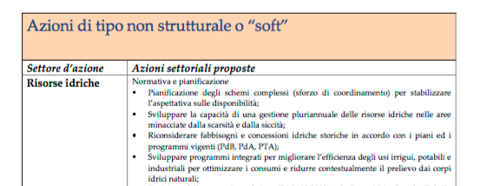
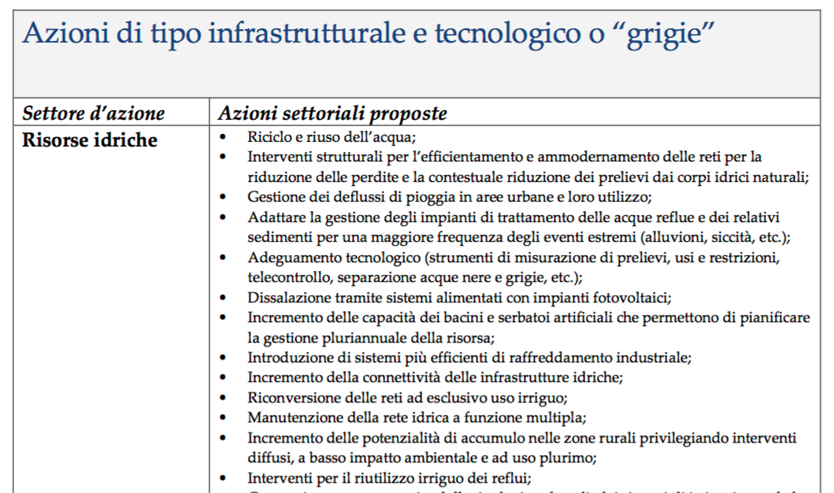
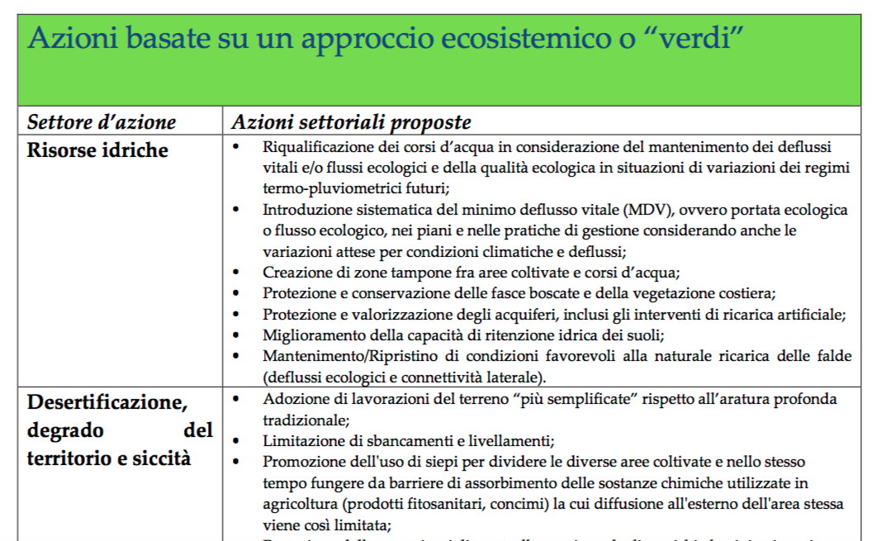

Slide 25
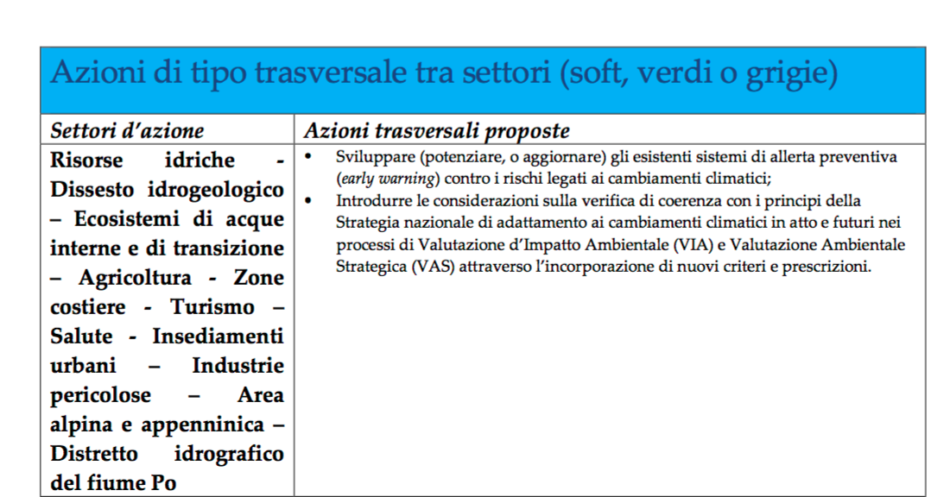
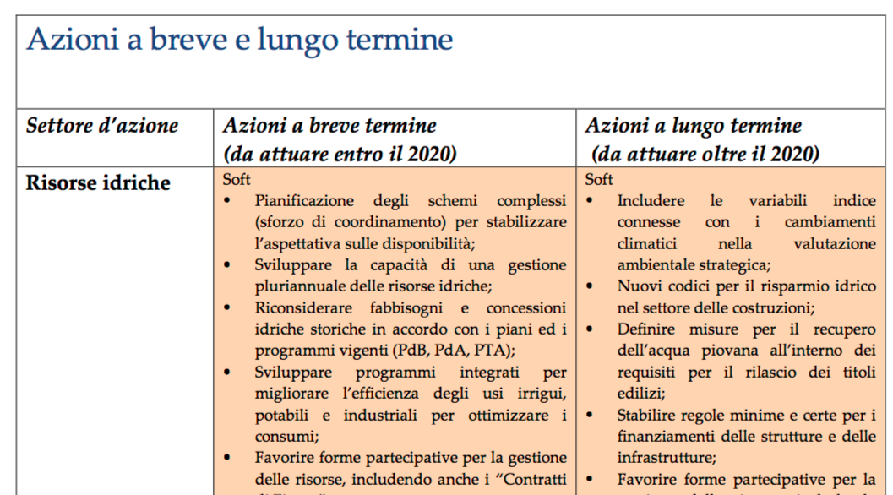

Slide 26
Principles for effective adaptation – Adaptive management
Name | Definition/scope | Examples
No regret | Measures that are worthwhile now, delivering net socio-economic benefits which exceed their costs, and that continue to be worthwhile irrespective of the nature of future climate Includes ‘soft’ measures that build adaptive capacity through supporting better understanding of risks, and governance on adaptation | Increase public awareness about social and economical consequences of climate change Improve understanding of the vulnerability of the coastal zone to sea level rise
Low regret | Measures for which the associated costs are relatively low and for which the benefits under future climate change may potentially be large Includes operational measures – i.e. changes in processes and procedures | Establish early warning systems for floods
Notes:
There are some specific categories of adaptation actions that perform well in the face of uncertainty.
These are
No or low regret
Win-win

Slide 27
Principles for effective adaptation – Adaptive management
Name | Definition / scope | Examples
‘Win-win’ | Measures which have other environmental, social or economic benefits as well as managing climate change | Improve building energy efficiency to reduce GHG emissions and better manage high temperatures
Flexible or adaptive | Measures that can be implemented incrementally, rather than through the adoption of ‘one-off’ costly adaptation solutions | Design coastal flood risk management strategies which can be easily modified / upgraded over time
Notes:
There is a very famous example of Adaptive management.
Thames Estuary 2100 plan in London, UK (TE2100 project). The plan has been designed to provide a great deal of flexibility to protect London and surrounding areas from future sea level rise. It includes a suite of individual flood protection measures – these can be brought on over time as knowledge and observations of SLR improve. Options are left open to deal with a range of possible different future climates

Slide 28
Tool for Appraising Adaptation Measures
Cost-Benefit Analysis (CBA):
  Comparison of the costs and benefits of a project expressed in monetary values, with one main objective, e.g. economic efficiency
  Example where CBA can be applied: Comparison of engineering options for rehabilitation of existing and construction of new water resource management facilities
Cost-Effectiveness Analysis (CEA)
  Analysis of costs of alternative adaptation options
  Compared with CBA, CEA is suitable where benefits cannot be defined in monetary terms
  Example where CEA can be applied: Preservation of fauna and flora species diversity → Measurable objective: the number of animals preserved and hectares of wetland or forest protected per invested monetary unit
Multi-criteria Analysis (MCA)
  Tool that is able to rank and prioritise multiple adaptation options.
  Ranks resulting from an MCA are not based purely on economic calculations, but on a broader range of criteria to capture wider objectives
  Example where MCA can be applied: Dealing with increased flood risk:
    - Four adaptation options could be analysed: 1) installing pumps, 2) improving drainage infrastructure, 3) organising manual labour, and 4) bearing the losses (doing nothing)
    - According to four criteria: 1) costs, 2) effectiveness in safeguarding agricultural production, 3) health benefits and 4) environmental effects

Slide 29
Tool for Appraising Adaptation Measures
Are costs and benefits of adaptation options measurable in monetary terms?
Yes
No
CBA
Is it possible to quantify cost and benefit of adaptation options at all?
CEA
Yes
No
Is it possible to quantify cost and benefit of adaptation options at all?
Yes
No
MCA
Other (non-economic) approaches
Source: https://gc21.giz.de/ibt/var/app/wp342deP/1443/wp-content/uploads/filebase/ms/mainstreaming-guides-manuals-reports/Economic_assessment_of_CC_adaptation_options_-_GIZ_2013.pdf

Slide 30
THE NATIONAL ADAPTATION STRATEGY PROJECT / STRATEGIC DOCUMENT
Cross-sectoral issues
Monitoring and observation systems for adaptation
Research needs for adaptation
Synergies between adaptation, mitigation and sustainable development
Disaster risk reduction and adaptation, including the role of insurance sector
Treatment of scientific uncertainties in the decisional process of adaptation

Slide 31
THE NATIONAL ADAPTATION STRATEGY PROJECT / STRATEGIC DOCUMENT
Conclusions and outlook
The NAS document foresees a number of next steps:
Establishment of a permanent national platform on adaptation for stakeholder engagement and communication
Development of comprehensive assessment of costs of climate impacts, as well as analysis of costs-benefits of adaptation measures in all the identified sectors
Development and implementation of a Plan of action for adaptation and/or sectoral plans that will identify adaptation actions, and a scheme for systematic monitoring and evaluation of progress
Review of technical content of NAS on a 5-year cycle

Slide 32
ADOPTION PROCESS
Steps for adoption of the NAS
NAS document finalised in September 2014:
In a session of the "Conferenza Unificata" on the 30th of October 2014 at the Council of Ministers Presidency level (Committee of Ministers, Regions and Municipalities that delivers advices on area of its jurisdiction) the Ministry of Environment presented the document named "Strategia Nazionale di Adattamento ai Cambiamenti climatici" (NAS) for final approval. Hence, the positive advice by the Conferenza Unificata was issued.
The NAS was finally adopted on June 2015 with a Directorial Decree of the Ministry of Environment, establishing specific objectives to be reached by 31st December 2016.
Notes:
The NAS has not binding legal status.

Slide 33
ADOPTION PROCESS
Directorial Decree by Ministry of Environment – June 2015
Specific objectives to be reached by 31st December 2016:
Update NAS document every 5 years
Establishment within Ministry of Environment of “Permanent Forum” for awareness raising and communication, and “National Observatory” for identification and monitoring of priorities of action by local and regional administrations representatives
Plan of action to be agreed by Conferenza Stato-Regioni including:
    Roles and responsibilities for implementation, and coordination mechanisms within the government
    Criteria for developing regional/local-scale climate scenarios
    Short-list of adaptation options
    Estimation of financial and human resources for implementation of adaptation options
    Indicators to measure success of adaptation measures
    Modalities for monitoring and evaluating impacts of adaptation measures
Notes:
The NAS has not binding legal status.

Slide 34
CONCLUSIONS
The Italian NAS is an example of satisfactory policy process achieved in a sensible timeframe, with relatively low financial resources available for the policy planning process itself.
It has provided a coherent framework for ongoing action, but is lacking real implementation without an action plan and/or sectoral action plans in place with precise allocation of roles, budget and timeframes
There is need for new climate research at the regional and local scale to be able to correctly prioritise sectoral action on adaptation
There is need for comprehensive national and sectoral economic assessments to be able to appraise and prioritise adaptation actions from the long list contained in the NAS
Nevertheless, mainstreaming and implementation of adaptation is happening at sectoral, regional and local levels

Slide 35
Thank you for your attention.
Hvala!
Dr. Sara Venturini
Climalia
Piazza della Manifattura, 1
38068 Rovereto (TN)
Italy
www.climalia.eu
sara.venturini@climalia.eu

