Slide 1

Austrian Adaptation policy approach:
From development to implementation and MRE
EPA IG Meeting, 10/11 March 2016
Andrea Prutsch
Workshop in Zagreb, 8th of September 2016
Notes:
In Austria we are working on the issue of adaptation since 2007. My name is Andrea Prutsch and I work for the Environment Agency Austria. Our agency and namley my colleuge Maria Balas and I have supported the Ministry in all steps been taken on the Adaptation journey.
I think we have come a long way in adaptation and have reached a number of positive results, but have also faced barriers… I am happy to share our experiences with you. The organiser of this WS asked me to target these experiences to transferable lessons learned.

Slide 2
Questions to be addressed and discussed with you:
From climate models → Impacts/vulnerabilities → Adaptation measures → Monitoring/Evaluation
Which sectors need to be addressed?
How to implement adaptation measures?
How to prioritize adaptation measures?
How to mainstream adaptation and how to assure coherence between sectors?
→ Coordination
How to involve the “right” stakeholders – focus on regional level and private sector?
…..
Notes:
Austria has passed the agenda-setting and policy formulation & inception phases and is currently in the implementation, monitoring and 1st policy revision phase.
Focus of my talk is on some major approaches, policy parts and respective experiences:
- participatory development process of strategy process
- characteristics of the policy documents
- selected elements of the implementation process
- M&E concept and first progress report
- concluding reflections
By doing so, I will address the following questions → cf. Slides
Please feel free to ask questions when ever you like; hope for a discussion

Slide 3
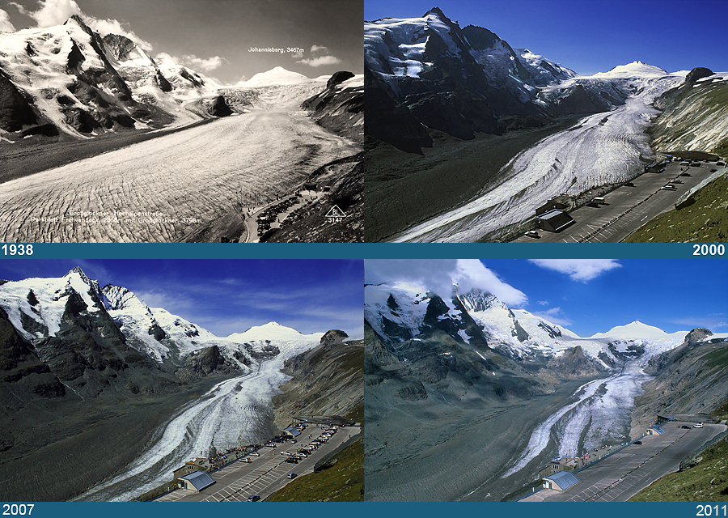
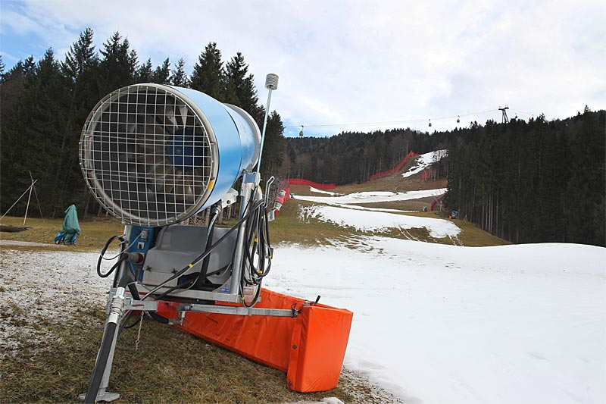
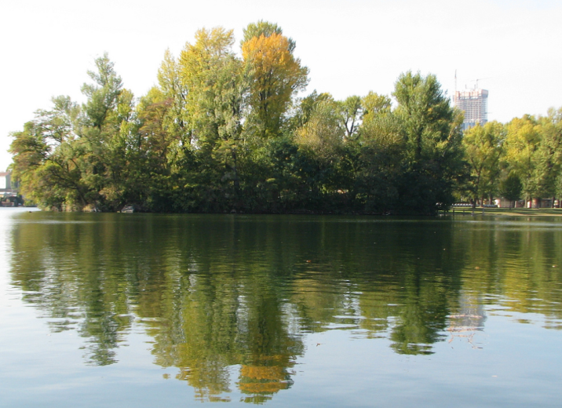

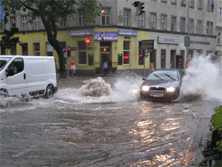
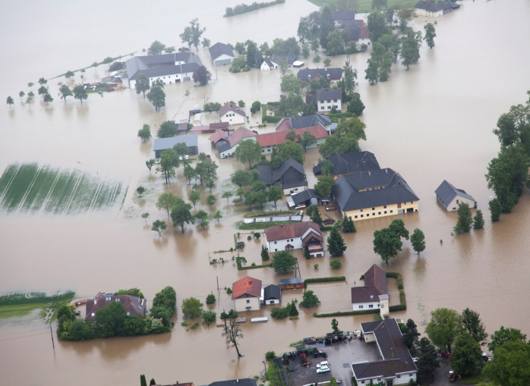
Climate change affects Austria already today…
Glacier retreat
Less snow cover
Change in vegetation
© Bild: Gletscherarchive.de
© Bild: APA/Hildenbrand
© Bild: McDowall
Heat
Heavy local percipitation
Floodings
© Bild: ORF/Hochmuth
© Bild: ORF/Hadler
© Bild: Landespolizeidirektion Oö
Notes:
Lets start with the problem - Austria faces a number of climate change effects already today…
In the last 200 years, mean temperature in Austria has increased, this has been recorded. Mean temperature lies 2 degree higher today, which is double as much as globally. So no suprise that climate induced changes are already visible today ….
Will not go into detail, but I guess some of them will be familiar to you anyways.

Slide 4
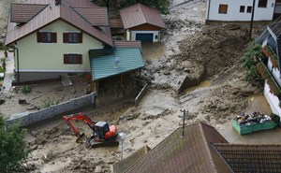

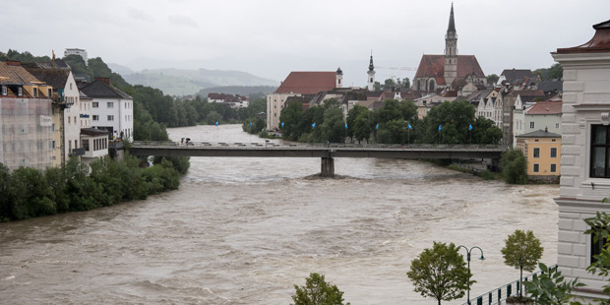
Adaptation is on the agenda since 2007, triggered by…
1) … experienced climate change impacts in the past → Austria faces already yearly climate related damage costs of approx. 700 Million Euro (from 2001-2010)
Summer 2016
© Bild: apa/gert eggenberger
APA/ÖHV
Notes:
Adaptation got more and more into the focus of policy makers on national level due to damage costs.

Slide 5

Adaptation is on the agenda since 2007, triggered by…
1) … experienced climate change impacts in the past → Austria faces already yearly climate related damage costs of approx. 700 Million Euro (from 2001-2010)
2) … international and European policy processes on Climate change adaptation
  International:
  Kyoto Protocol 2005 (Article 10b) under the UNFCCC process → Requests for national adaptation initiatives
  Paris Agreement 2015 → Strengthen adaptation as second column of climate policy, provides funding within Green Climate Fund
  UNFCCC Communications → to be delivered every 4 years, reporting on adaptation should be considered in a comprehensive way (new guidelines available)
Notes:
Second reason was the need to address adaptation caused by international and European requirements.
→ Slide

Slide 6

Adaptation is on the agenda since 2007, triggered by…
… experienced climate change impacts in the past → Austria faces already yearly climate related damage costs of approx. 700 Million Euro (from 2001-2010)
2.) … international and European policy processes on Climate change adaptation
  European:
  Adaptation on the agenda since 2005
  (establishment of working group on adaptation)
  Green paper on adaptation in 2007 followed by a White paper on adaptation in 2009
  EU Adaptation strategy available since 2013 → revision planned for 2016/2017
  Website CLIMATE-ADAPT launched → climate-adapt.eea.europa.eu/
Quelle: kallejipp/photocase.com
Notes:
As important as international requirements were the onces from the EC.
→ Slide

Slide 7
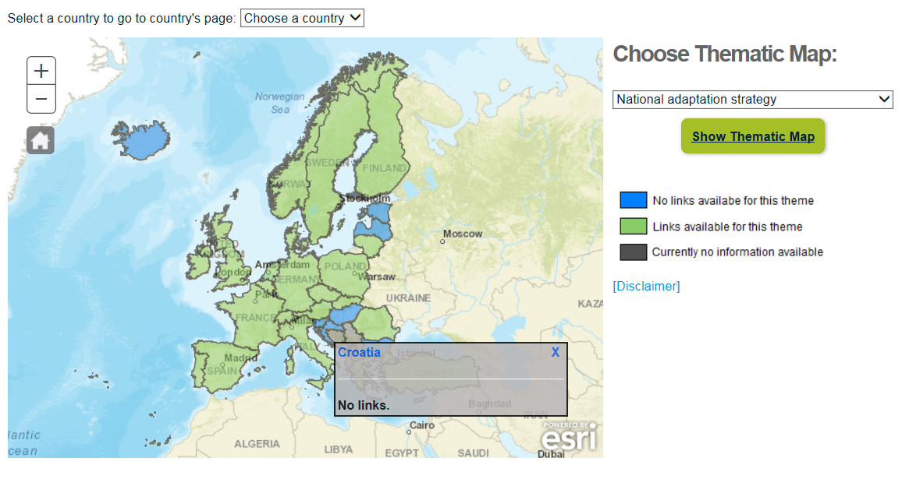
Information on Climate-ADAPT: Country Information
Notes:
Climate-ADAPT summarises all CC-impact, vulnerability and adaptation relevant information across Europe. It was developed within the implementation of the EU White paper and builds one important part for implementing the EU Adaptation Strategy. Currently, it is hosted by the EEA with support by the Topic Center.
On Climate-ADAPT you will find a huge data base on information, clustered according to sectors, but also regions and topics. In addition, a Adaptation Support Tool can be found on the website which helps you through the adaptation process. These information are in line with the DG CLIMA guidance on developing adaptation policies.
Another piece of information might be of interest for you: the Country pages on Climate – ADAPT. This page provides you an overview on adaptation activities in all EEA member countries – including Croatia. It shows you if countries have a NAS/NAP and provides you relevant links and information. In addition, it summarises main aspects in written format, such as policy process, content of strategies, available risk assessment, infos on MRE etc. I mention this as it might be of special relevance for you: currently, DG CLIMA via the EEA has send out a request to the countries to update this information on Climate-ADAPT as this will be taken as basis for the country fiches. Why do I mention that? The Country fiches are quit important: they will build the basis to evaluate the adaptation performance in countries. This will help DG CLIMA to gain an European wide overview on the activities and progress in countries. If DG CLIMA considers the progress as insufficient, a legal requirement is possible.
In case of Croatia, no information is integrated yet.

Slide 8

Adaptation policy development process in Austria

Slide 9
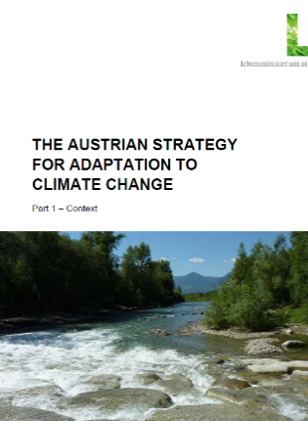
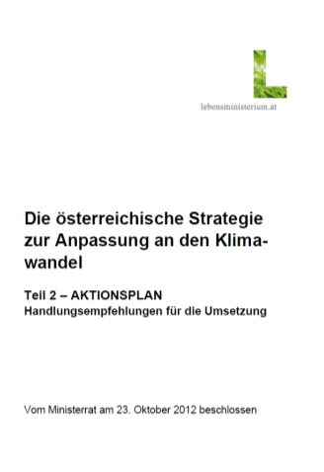
Austrian adaptation policy process
Main responsibility, process owner:
Federal Ministry of Agriculture, Forestry,
Environment and Water Management
Support unit: Environment Agency Austria
Kick off and political mandate
Start of NAS/NAP Development process:
Stakeholder involvement
NAS/NAP taken note of by the provinces
Start work on Monitoring including stakeholders
2007 2008 2009 2010 2011 2012 2013 2014 2015 2016
Climate – and Energy Funds establishs research program (ACRP)
Austrian Adaptation Strategy (NAS) & Action Plan (NAP) adopted
1st Progress Report on Adaptation published
Revise NAS/NAP
Notes:
Start: 2007 (initial impulses by the Kyoto Forum, preparatory work)
Political mandate: goal in the federal government program 2008-2013 (incl. involvement of stakeholders & the public) and 2013-2018 (for implementation & evaluation)
Step-wise, iterative and (predominantly) sector-based approach
NAS and NAP jointly developed

Slide 10
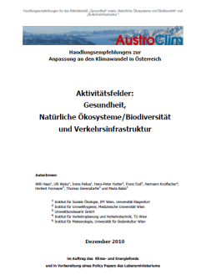
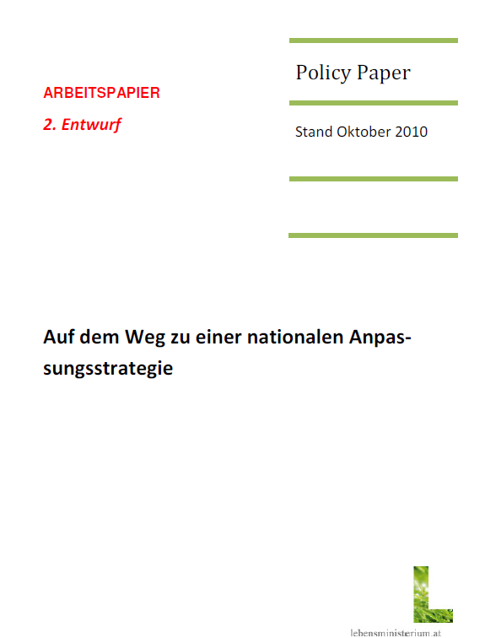
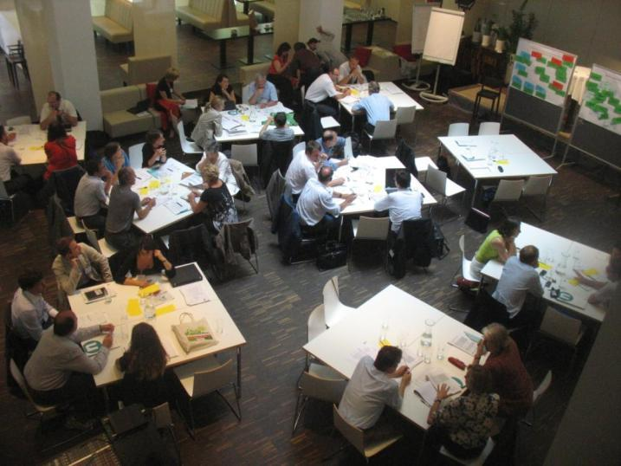
Development process of NAS/NAP (2008-2012)
  Sector-specific input documents
  including information on climate change and vulnerability
E-Mail survey with scientists
AustroClim including approx. 600 climate change and impact scientists
Revised sector-specific input documents
including adaptation options
1-2 sector specific workshops with scientists &
Presentation of results at public meetings (called informal WS)
health, ecosystems & biodiversity,
transport infrastructure
Integration into „Policy Paper“
(gradually developed into NAP)
Consultation rounds on NAS /NAP drafts
sent by responsible Ministry
Participation
process
✦
agriculture, forestry, water, tourism, energy, natural hazards, housing & construction,
Notes:
Long development process of NAS/NAP: many stakeholders involved, NAS and NAP integrated developed, comprehensive policy documents focusing on many sectors vulnerable to CC
Evidence-based, science-driven
Several closely aligned work streams
Iterative process for 14 sectors, each sector has been developed slightly different (depending on the timing, on information available, etc…)
Scientific and expert studies on sectoral vulnerability assessments – qualitativ, by then not a lot of information was available
Based on this studies, Email survey and workshops with scientists/experts to develop first proposals for adaptation options
Written consultation rounds on drafts of NAS/NAP (“policy paper”)
Broad and intense stakeholder participation process on national level
Continuously integrated into “policy paper” (working document)
Furthermore
Series of “Informal Workshops” (organized by Ministry)
Online consultation of broad public
Internet adaptation platform, online database of existing adaptation activities (research & practice), newsletter

Slide 11
Development process of NAS/NAP (2008-2012)
Scientific and expert studies
(vulnerability assessments, proposals for adaptation options)
agriculture, forestry, water, tourism, energy, biodiversity,……
Decisional Participation process
Policy Paper
3 written consultation
rounds
✦
Results
Part 1: Context
Part 2: Action Plan
Notes:
This slide shows the influence of the decisional participation process on the policy documents.

Slide 12
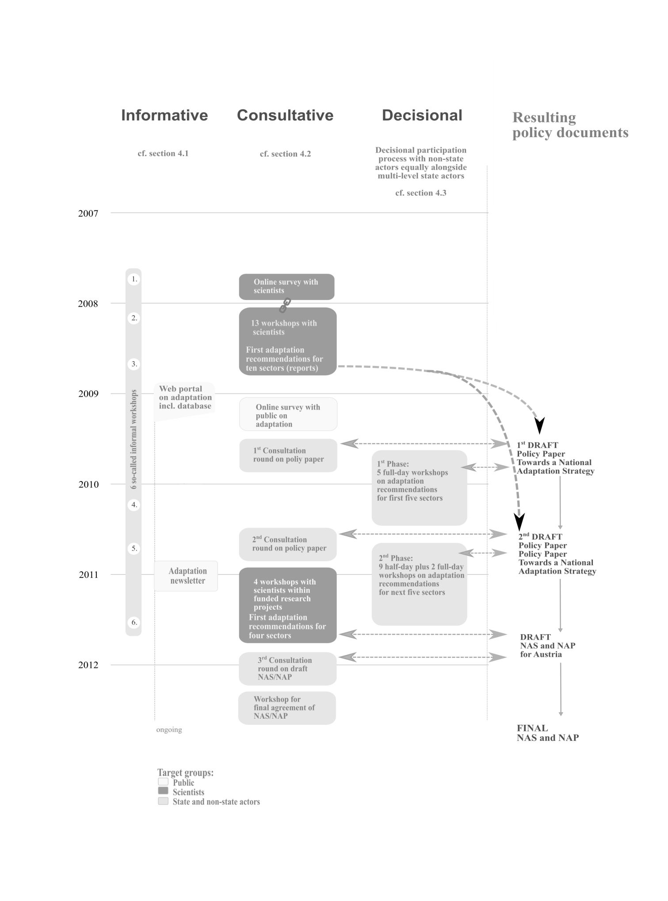
Overview of stakeholder involvement in Austria
Source: Prutsch et al. unpublished
Notes:
Stakeholder involvement was of high importance for the Austrian policy process. Thus, over years various stakeholder groups have been involved – to various degrees.
Comprehensive coverage of levels of stakeholder engagement: information, consultation, decisional (active involvement in policy drafting)

Slide 13
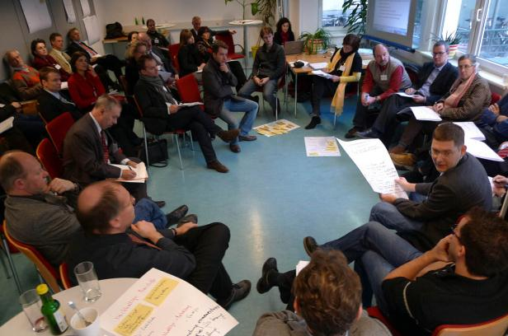
Decisional Participation process
Conducted by the Environment Agency Austria in close cooperation with responsible Ministry and Kyoto Forum (steering group)
16 workshops from 2009-2011
106 institutions (>670 persons) actively involved
Composition of participants:
  1/3 federal ministries, provincial authorities, large businesses / service providers
  1/3 organized interest groups: social partners, chambers, etc.
  1/3 social/environmental NGOs, civil society organizations, private companies (e.g. insurances)
Objectives:
  Raise awareness
  Provide a platform for exchange
  Improve the NAS/NAP quality
  Enhance the acceptance
  Facilitate the implementation
Notes:
Decisional Participation process for development of NAS/NAP was unique in Europe
Active involvement over a couple of years → slide.
Unique was also the composition of participants: public administration from various ministries on national and provincial level had more or less the same possibilities to participate than NGOs and interest groups.

Slide 14
Decisional Participation process
Stakeholder analyses
Relevant stakeholders were identified through questions such as:
Who can influence decisions in regard to adaptation?
Who is responsible for implementing (and financing) the potential adaptation action?
Who can increase the effectiveness of the adaptation action through participation or decrease its effectiveness by non-participation?
…
Invitation to nominate 2 representatives who have the mandate to bring in the organizations interest and report back
Notes:
How did we analyse the „right“ stakeholders?
Based on a couple of questions such as… → Slide
A number of stakeholders/organisations were the usual suspects … already on several mailing lists provided from the Ministry. Other persons were newly identified. The final stakeholder list was agreed with the Ministry.
After that we have invited stakeholders via mail to ask if they are interested to participate and nominate 2 persons. In case of no reply, we phoned them and searched a personal talk.
Only two organisations declined the invitation. All the others agreed to participate – actively or by being informed (via minutes).

Slide 15
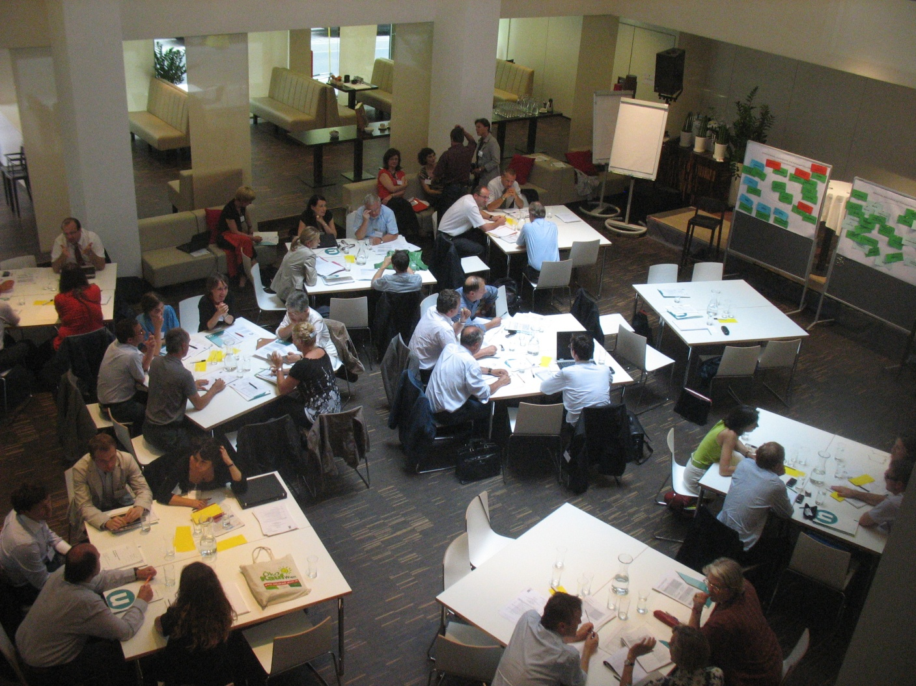
Decisional Participation process
Stakeholders role
Stakeholder’s role can be described as “practical experts” complementing the adaptation recommendations provided by scientist (discussion base =
Policy Paper)
Influence on „corner stones“ of the strategy
Notes:
Decisional participation process → stakeholder have the power to influence the result of the policy document. That was the case → Slide

Slide 16
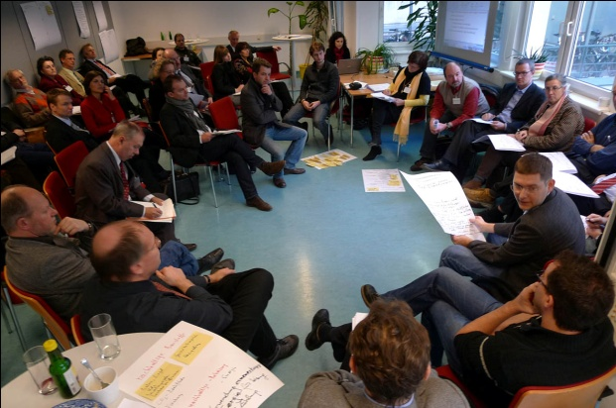
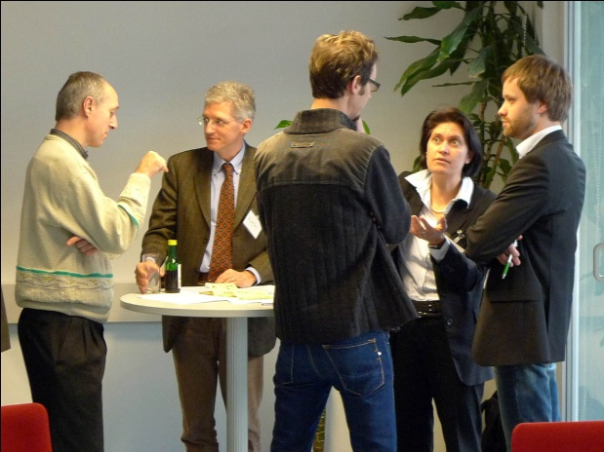
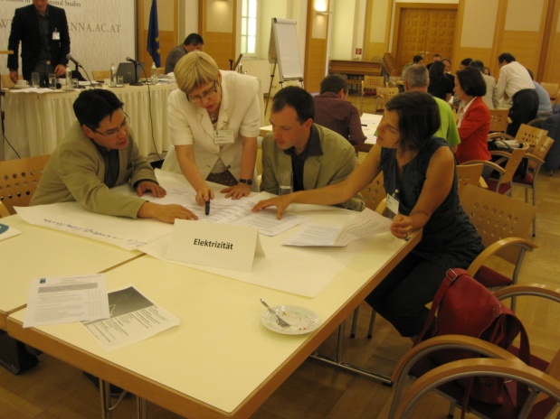
Decisional Participation process – lessons learned
KEY MESSAGE:
Overall, it had effects (i.e. it raises awareness, builds capacities and facilitates exchange, enhanced the quality of the policy document), but that it is not able to overhaul the weaknesses of comprehensive policy strategies
Recommend to be specific on …
    purpose of process
    roles of involved parties
    tasks for stakeholders
    expected outcomes and use of outcomes
    limits of process
Notes:
Adaptaiton policymaking is challenging because its multi-sectoral character requires effective coordination and commitment in many sectors. Policy coordination between sectors and levels of government can take place separate from or intertwined with the participation of non-state actors. Our case has shown that combining policy coordination and participation can offer an efficient way to raise awareness among a broad variety of actors with one comprehensive process. On the other hand, however, we also saw that intertwining them can make it difficult to resolve political controversies, and that it can also hamper the institutionalisation of coordination with negative consequences for implementation. In concurrence with Bizikova et al. (2014) we recommend that participatory and coordinative governance mechanisms should not substitute but complement each other because they serve different purposes. If coordination takes place at high political levels it may even facilitate political commitment so that participation is taken more seriously and participants send negotiators instead of listeners.
The case has demonstrated that transparent procedures and clear rules are important for effective participation, also for managing expectations and securing satisfaction of the participants (Few et al. 2006, Larsen & Gunnarsson-Östling 2009). Regarding important rules mentioned in the participation literature (see e.g. Glicken 2000, Reed 2008, Lebel et al. 2010, Grothmann et al. 2014) we can confirm the following: (i) Rules, roles, expectations and limits have to be communicated clearly from the beginning. (ii) To mobilise all important stakeholders and to avoid asymmetric stakeholder representation, financial support (in particular for NGOs) should be considered. (iii) To safeguard satisfaction and motivation for future involvement, the effects of participation should be substantial and transparently documented. However, we also found that transparent procedures and clear rules should not suppress flexibility that may be necessary to cope with conflictual situations. Since it is impossible to determine what this implies on the ground, we recommend that participation requires skilled, neutral facilitators that are able to detect difficult situations early on and respond adequately.

Slide 17
Experiences and reflections with focus on Formulation
    Step-wise, iterative and sector-based approach, combining the development of NAS and NAP, was a very long and complex process, partly difficult to communicate
    Participation of various stakeholders in policy formulation contributed positive to the process as it helped to raise awareness on the issue, build capacities, improved the quality of the policy documents, etc.
    Strong role of science at the beginning of the policy formulation process added to the quality of the policies and enhanced the acceptance of the adaptation options → interaction throughout the development process was limited and could have been increased
    Missing vertical (with public authorities on sub-national levels) and horizontal (with other Ministries on national level) coordination in formulation stage → took place within the decisional participation process together with non-state stakeholders → high-level controversies over who is responsible for what were difficult to solve

Slide 18

Adaptation policy decision process

Slide 19
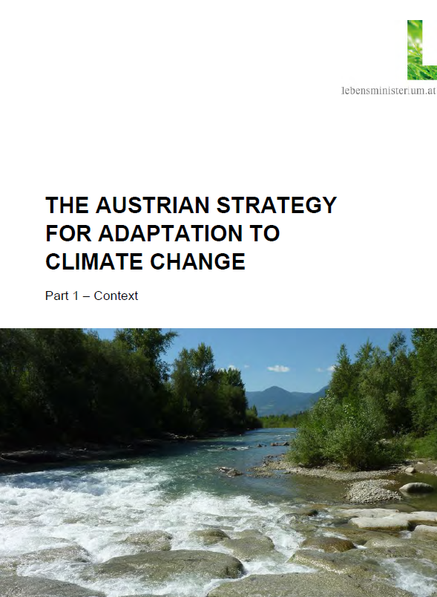
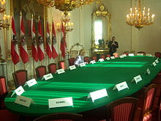
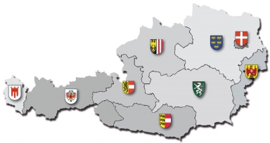
Political adoption of the Austrian NAS/NAP
approved by the Austrian Council of Ministers on Oct. 23rd 2012
taken note of by the provinces („Landeshauptleutekonferenz“)
on May 16th 2013
Download: http://klimaanpassung.lebensministerium.at
Notes:
Finally, after a 4 year long development process, the NAS/NAP has been adopted in October 2012 by the Austrian Council of Ministers
In addition, it has taken note of by the provinces in May 2013 – important as Austria is federal organised and the responsibilities are mainly shared among national and provincial level (a few responsibilities lay within the communities)

Slide 20
National Adaptation Strategy and Action Plan
Country-wide strategic framework for joint, coordinated, coherent action
Integrated, comprehensive, broad strategy with sectoral approach
Two parts
Part I: Strategic framework and context
  Including: policy objectives, information on climate change impacts, guiding principles, prioritization criteria, cross-cutting recommendations for implementation, social aspects
  Part II: Action Plan
    14 activity fields (sectors)
    132 recommendations for action
    High level of concreteness, specifies many concrete starting points for implementation
Notes:
Whats available is a country wide strategic framework – cf. Slide

Slide 21
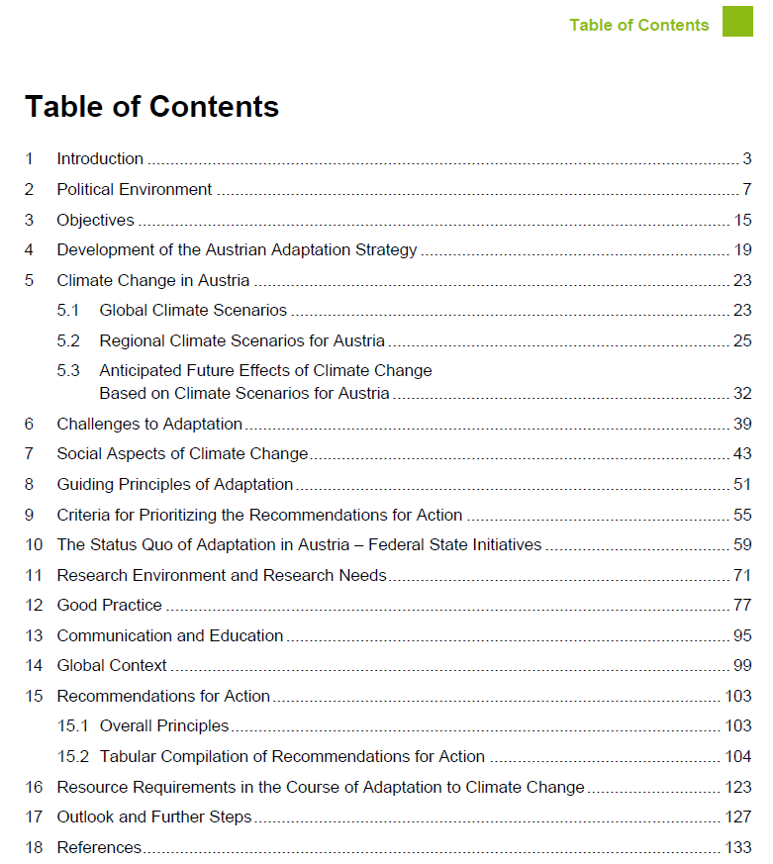
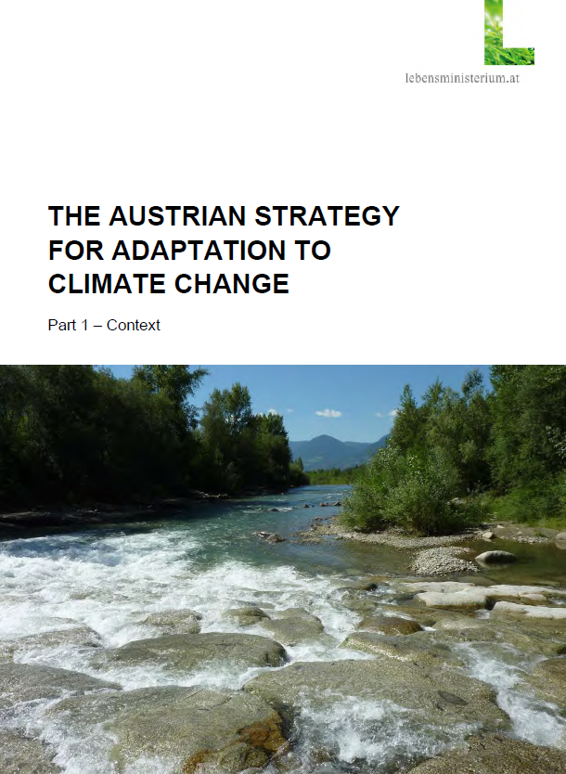
Part I: Context
Notes:
Slide

Slide 22
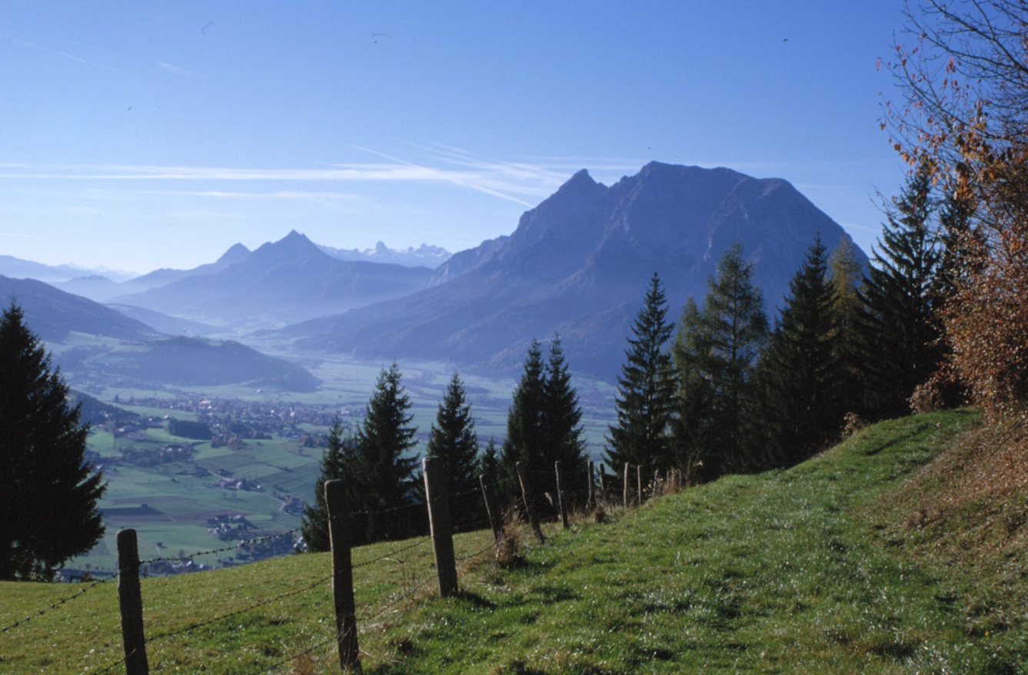
Austrian Adaptation Strategy (Context)
Overall aim
to reduce anticipated negative impacts of climate change on Austria's society, economy and environment
to use positive effects of climate change and allow synergies
to provide an overall framework in which adaptation should take place
Overall principles
Preventive action in line with the precautionary principle
Flexible and/or robust measures (win-win, no-regret, co-benefits)
Making use of synergies through cooperation (e.g. mitigation)
Considering interdependencies between sectors and avoiding conflicts
Avoiding maladaptive outcomes (unsustainable pathways, negative external effects)
Notes:
The overall aims of the NAS are → Slide
With the strategy, a number of principles are followed → Slide

Slide 23
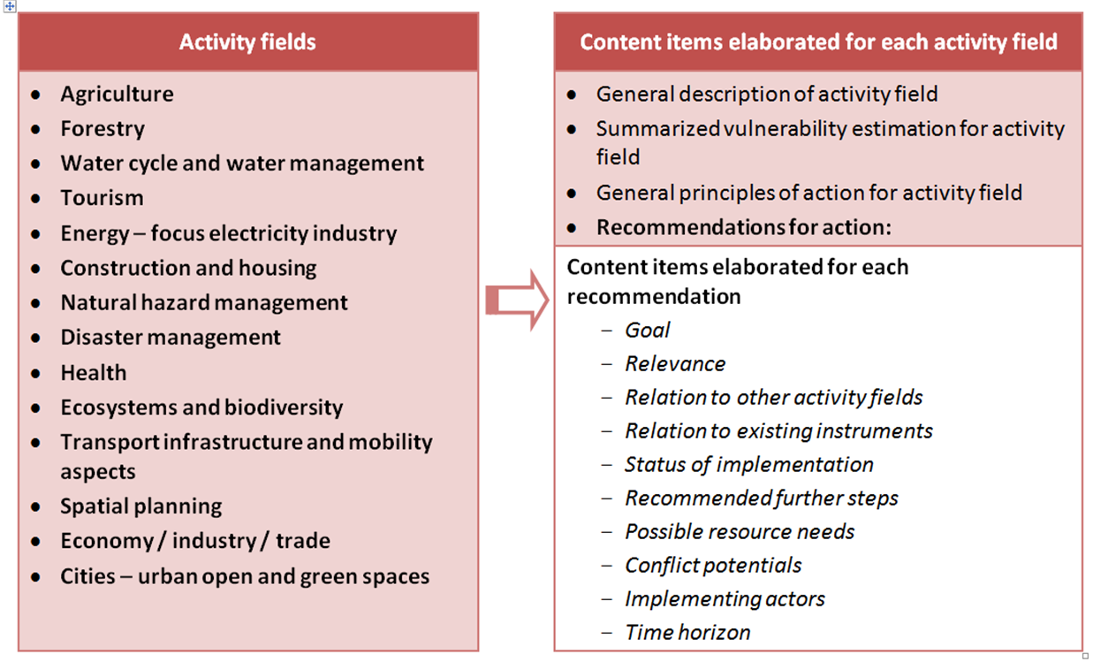
Part II: Action Plan
Notes:
→ Slide

Slide 24
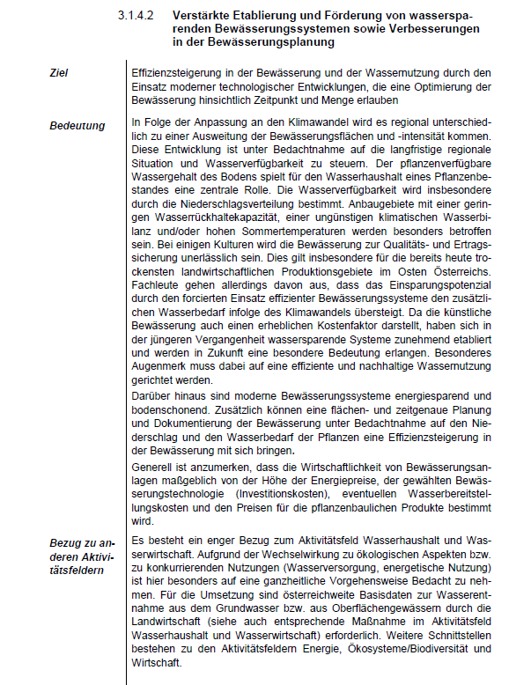
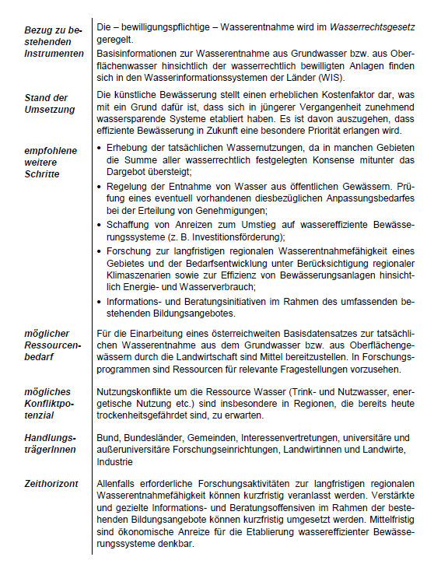
Measures follow the same structure …
Notes:
This shows exemplarily a measure of the NAP and how it is descried and presented.
Structure:
title of the measure and aim
Why is it important in regard to adaptation
What existing instruments and policies can be used in order to mainstream this aspect/measure
What is the actual state of implementation
What next steps towards implementation are needed
What resources are needed
Are there potential conflicts with other measures/policy fields
Who should implement the measures
What is the time frame for implementation

Slide 25
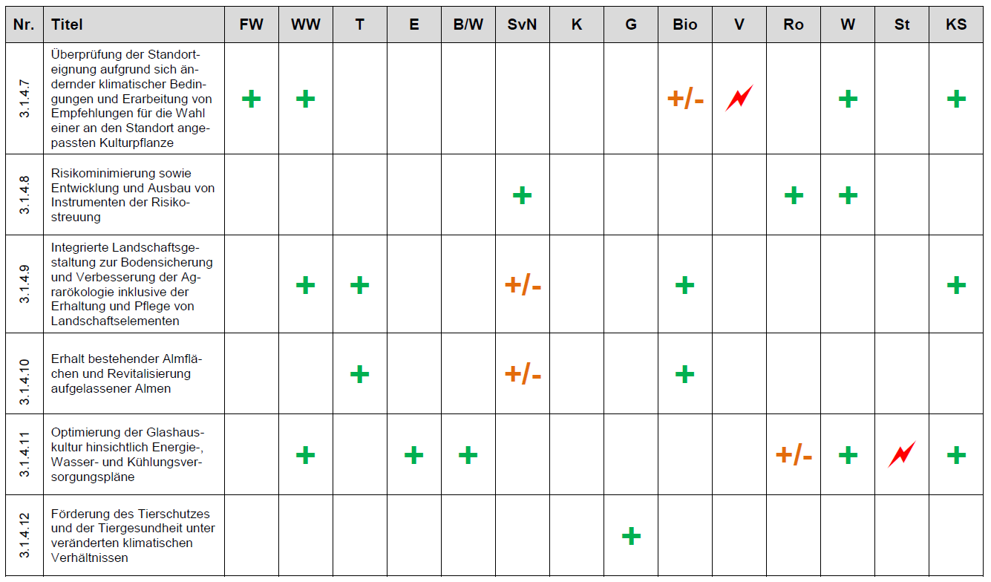
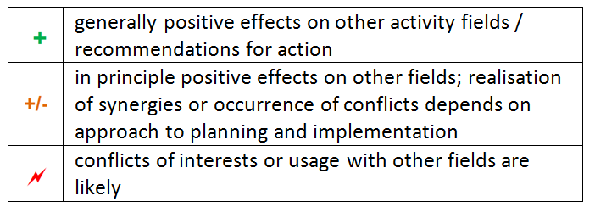
Analysis of cross-sectorial interactions
Agriculture

Slide 26
Experiences and reflections with focus on Decision
    NAS/NAP is very comprehensive with high level of detail → compendium of knowledge, but difficult to guide the implementation process
    NAP supports mainstreaming in a meaningful way
      Entry points (e.g. instruments) in other sectors/policies identified
      Recommendations/measures are often cross-cutting
      Cross-sector relations and conflict potentials consistently described
    Implementing actors identified, but not assigned → no commitment could be reached
    Criteria for prioritizing actions provided → setting priorities was proponed to the implementation process
    Resource needs addressed in qualitative terms, but not quantified → therefore, the level of detail is not appropriated
    General statement on financing is included in NAS → should happen within existing public budgets

Slide 27

Implementation of adaptation

Slide 28
Implementation process
    Work Program of the Austrian Federal Government 2013-2018: Evaluation and implementation of NAS stated as a goal
    Vertical coordination of NAS implementation between Ministry and provincial states (climate coordination officers) still works mostly in informal ways
      no permanent institutionalized coordination body
      benefits from institutional and personal relationships built during participatory strategy development
Notes:
We still have the political agreement to continue working on climate change adaptation in Austria – included in the Federal Governmental Work Programme
→ SLIDE

Slide 29
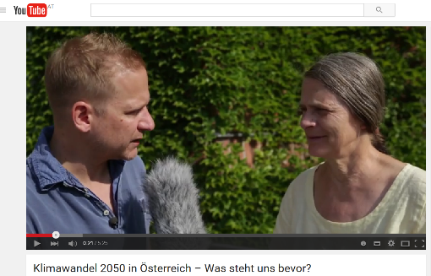
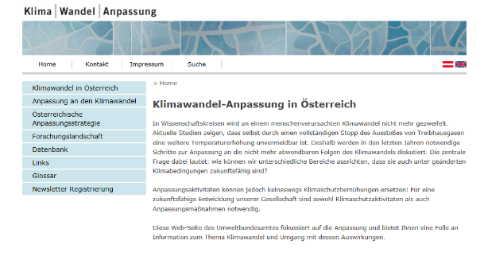
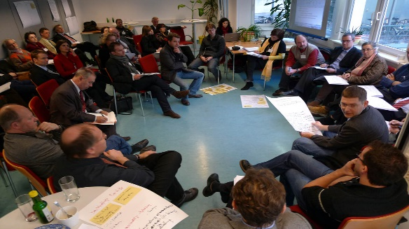

Implementation process – some highlights ☺
    Most provinces have adopted (or are currently working on) Regional Adaptation Strategies
Notes:
In Austria, adaptation has reached the provincial level → Slide

Slide 30
Implementation in the provinces – status & planned
Provincial adaptation strategy adopted
Adaptation measures/aspects considered/included in existing climate and energy program
Lower Austria: CCA aspects considered in new climate and energy program
Integrated mitigation and adaptation strategy adopted
Vienna: CCA measures addressed in climate and energy program
Work program of adaptation measures planned, preparation phase has started
Upper Austria: RAS adopted in 2013
No separate adaptation strategy available or planned, but adaptation measures incorporated in
sector policies
Tyrol: Integrated mitigation & adaptation program adopted in 2015
Salzburg: preparatory work for program of CCA measures
Vorarlberg: adopted in 2016
Styria: adopted in 2015
Burgenland: no own adaptation strategy, sectorial approach
Carinthia: preparatory work for program of CCA measures
Umweltbundesamt, status September 2016
Notes:
All provinces are working on the issue of adaptation

Slide 31
Implementation process – some highlights ☺
    Most provinces have adopted (or are currently working on) Regional Adaptation Strategies
    Mainstreaming efforts enhanced (e.g. CAP, forest policies, health)
    Communication and awareness raising increased – website, newsletter, brochure, videos, workshops in provinces and regions, etc.
Notes:
Also mainstreaming adaptation into other policies has increased. We see various expamples → Slide
CAP 2014 – 2018
Forest strategy for Austria
Health policy – new diseases, allergies, heat issues

Slide 32
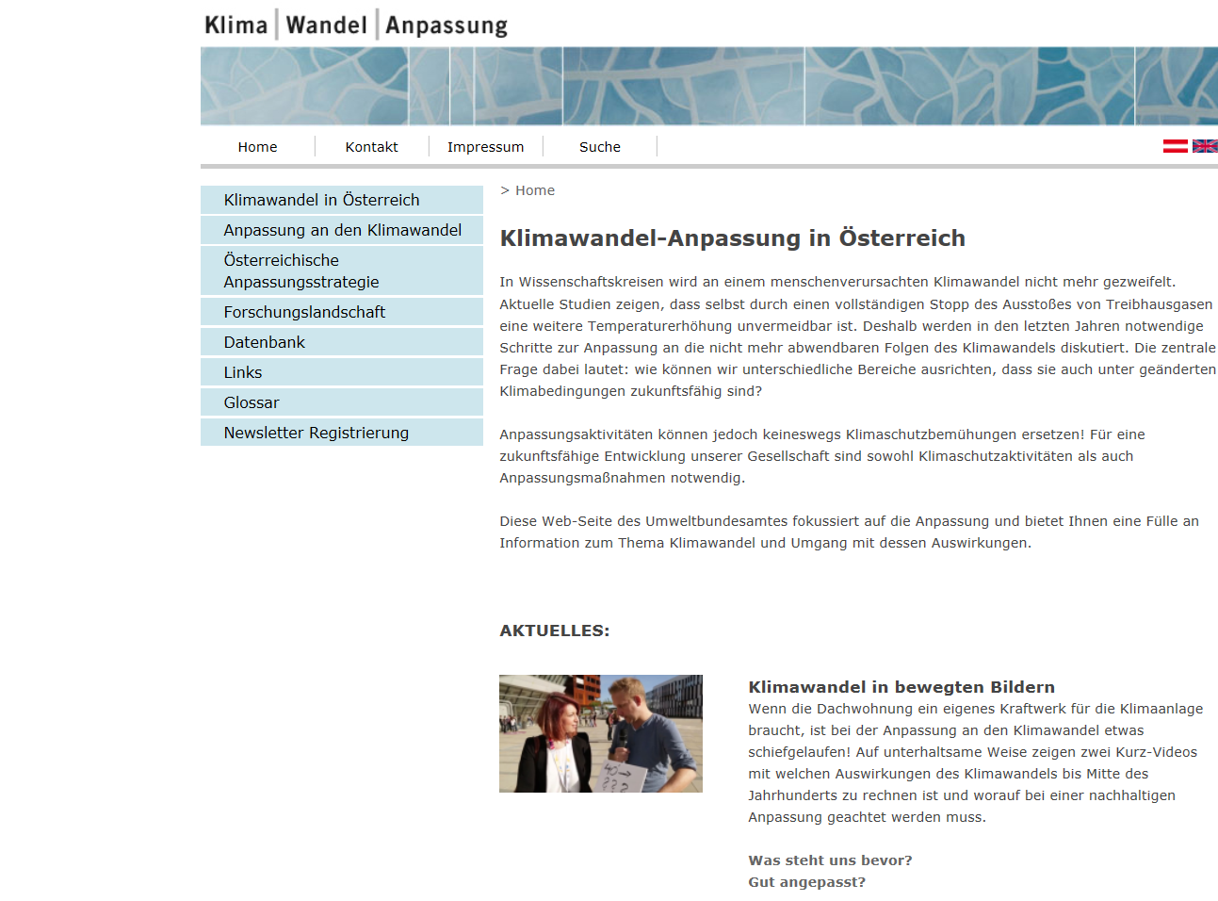
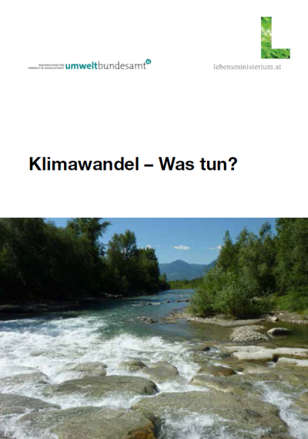
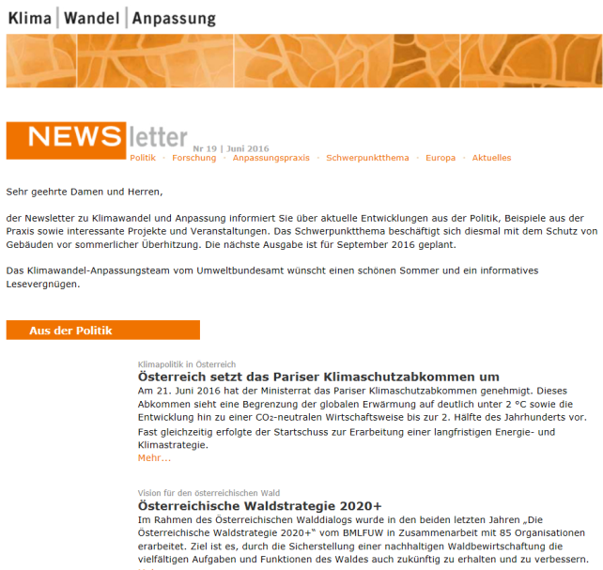
www.klimawandelanpassung.at
Communication
Newsletter
Notes:
Information provision of importance for several years. Main product is website which we from the EAA host. Most information in DE, but also a few pages in EN. Target group is broad public interested in CC and CCA.
A newsletter is now published 6 times a year, dedicated to policy makers and interested audience
Broad public is also addressed with the brochure Climate change – what can we do? Focus on Climate change adaptation

Slide 33
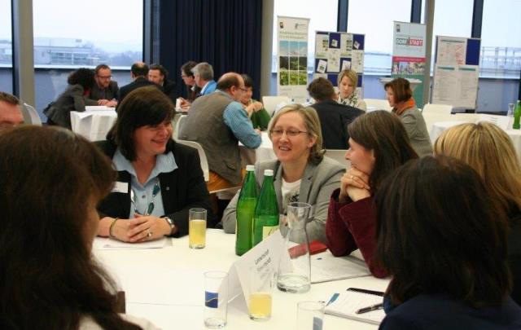
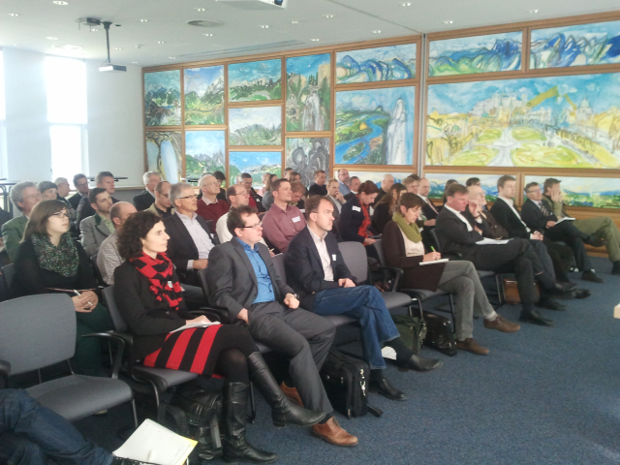
Dialogue events in the provinces
Communication
    Interactive workshops with provincial stakeholders conducted by the EAA
    Offer by the Ministry to provinces to promote NAS/NAP and kick off/support strategy building processes in provinces
    Important for capacity building:
      demonstrates commitment from federal level and
      supports provincial climate officers in their work
      coupling and “translating” the NAS/NAP to specific
      requirements of the provinces
    Very positive resonance: continuation and extension
    to other target groups → regions → 12 further workshops are financed and planned for 2016/2017
Notes:
SLIDE

Slide 34
Implementation process – some highlights ☺
    Most provinces have adopted (or are currently working on) Regional Adaptation Strategies
    Mainstreaming efforts enhanced (e.g. CAP, forest policies, health)
    Communication and awareness raising increased – website, newsletter, brochure, videos, workshops in provinces and regions, etc.
    First APCC report on climate change, mitigation and adaptation published in 2014

Slide 35
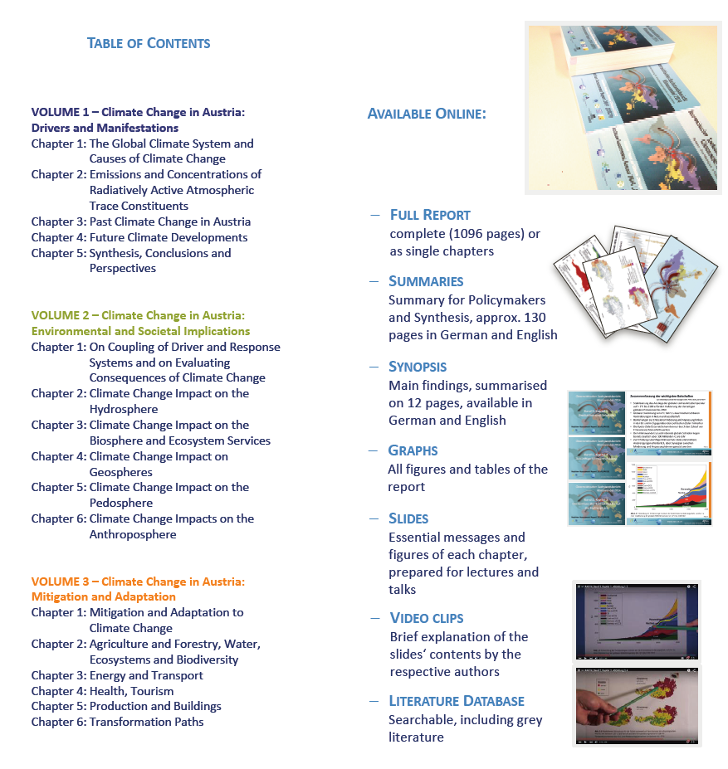
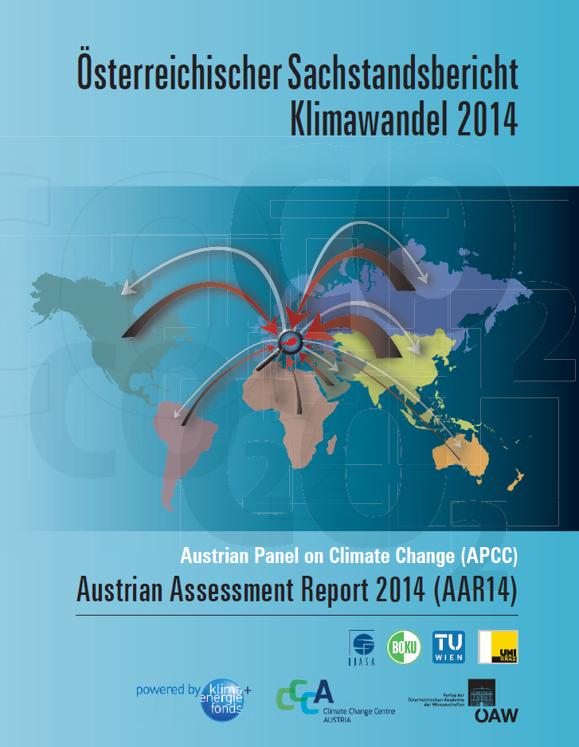
First APCC report on climate change, mitigation & adaptation
    Austrian Assessment Report 2014 (AAR14) follows the model of the IPCC Assessment Reports
    more than 200 scientists contributed to the state of knowledge on climate change in Austria
    resulted into a comprehensive and detailed scientific assessment of the state of knowledge for Austria (>1,000 pages)
www.ccca.ac.at/en/apcc/austrian-assessment-report-apcc-aar14-information-and-materials/
Notes:
SLIDE

Slide 36
Implementation process – some highlights ☺
    Most provinces have adopted (or are currently working on) Regional Adaptation Strategies
    Mainstreaming efforts enhanced (e.g. CAP, forest policies, health)
    Communication and awareness raising increased – website, newsletter, brochure, videos, workshops in provinces and regions, etc.
    First APCC report on climate change, mitigation and adaptation published in 2014#
    Various research projects to support implementation carried out, such as the study on cost of inactions (COIN), costs of private/public adaptation (PATCHES, PACINAS), adaptation tools to support municipalities (FAMOUS, CC-ACT), etc.
Notes:
Slide

Slide 37
Research in Austria
    Research programms
    Austrian Climate Research Program (ACRP), operated by Climate and Energy Fund: strategically aligned with policy-making; regularly funding projects in support of NAS/NAP implementation
    StartClim: financed by donor consortium (ministries, prov. governments, private sector)
    Research community
    CCCA – Climate Change Center Austria: network of research and brokerage institutions founded in 2011
      CCCA has 23 full and four supporting members
      CCCA is a contact point for researchers, politicians, the media, and the public for all questions concerning climate research in Austria
      Three operational bodies: (1) Coordination office, (2) Service Centre, (3) Data Centre
Notes:
Slide

Slide 38
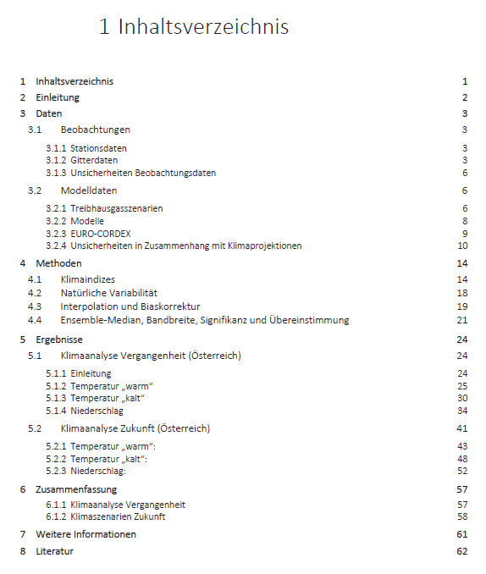
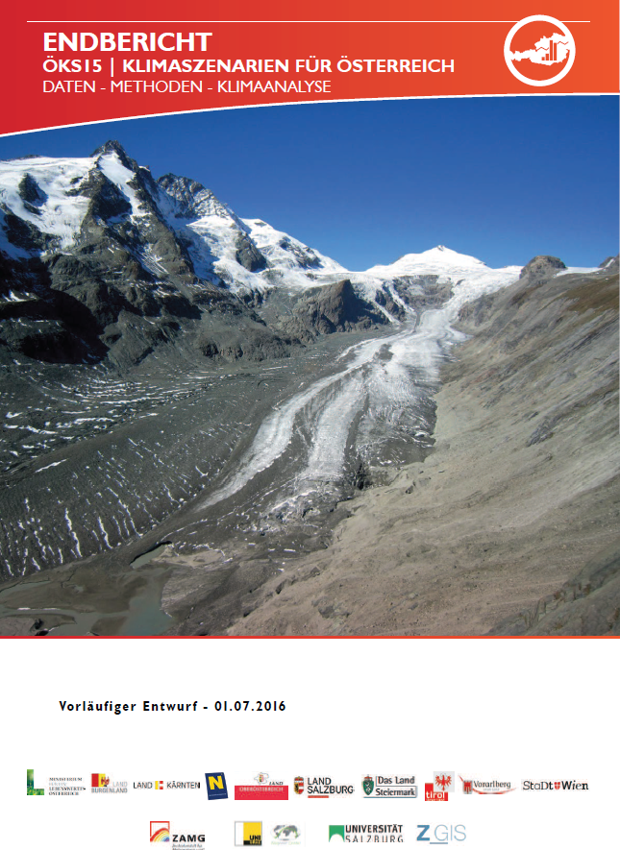
New regional climate scenarios for Austria
    Joint procurement by Ministry of Environment and the 9 provinces
    Best available historical data and latest climate simulations (until 2100) for Austria on a 1x1km grid
    Optimized preparation for decision-makers
    Fact sheets for each province available and for each municipality (if requested)
Notes:
Slide

Slide 39


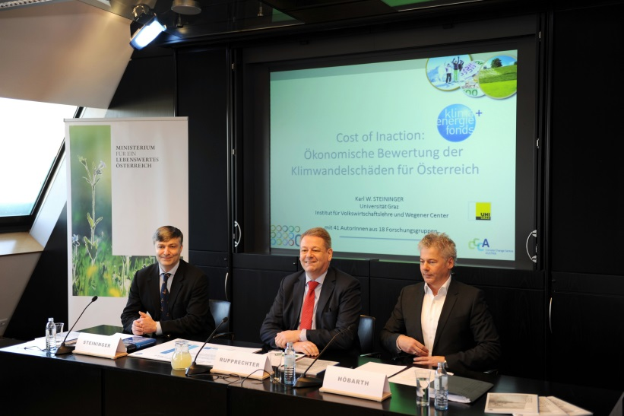
Research project for policy support
    COIN – Costs of Inaction
Quantitative assessment of the costs of climate change in Austria (without planned/anticipatory adaptation, without further mitigation)
COIN draws a clear picture of the cost sensitivities for 13 fields of activity (→ from NAS/NAP) for priority impact chains, incl. macro-economic effects
Large project consortium (lead: Wegener Center, Graz), financed by Austrian Climate and Energy Fund
Internationally unique!
Wide media coverage, strong public
attention
Provides strong arguments to motivate
and convince stakeholders to take action
Notes:
Slide

Slide 40
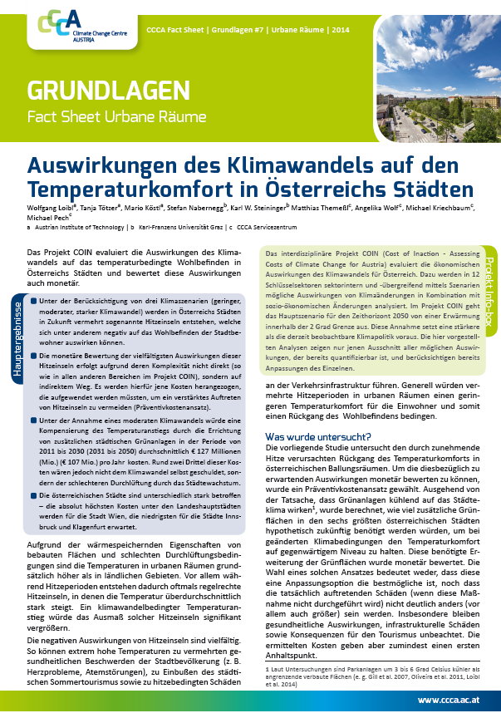
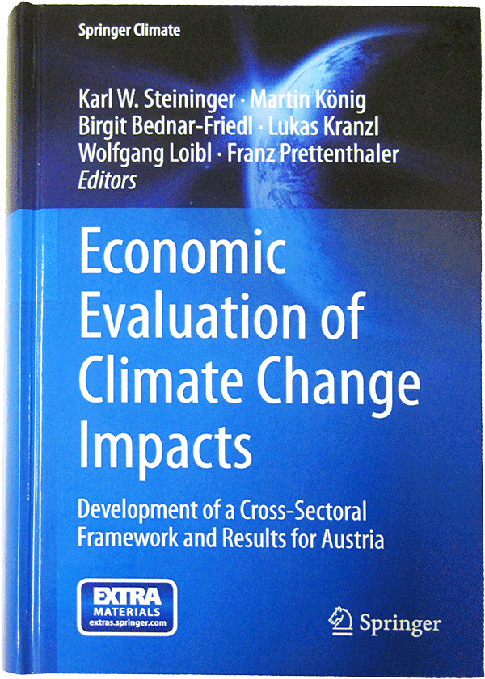
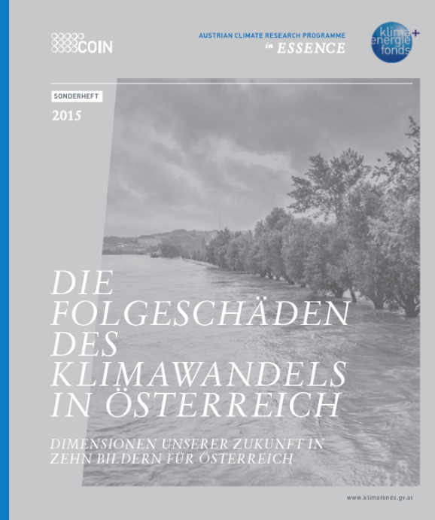
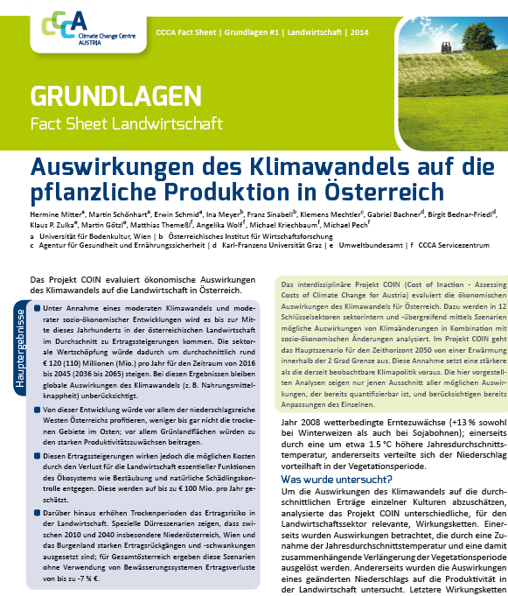
Effective communication products
Highly readable summary formats:
8-page summary
Fact sheets
ACRP special issue in narrative style
Scientific book publication
“Road touring” of consortium members
Results:
http://coin.ccca.at/

Slide 41
Research project for policy support
    FAMOUS and CC-ACT – Foster adaptation on regional & local level
Lead: Environment Agency Austria
Partner: University of Natural Resources and Life Sciences,
Umweldachverband and UKCIP (for CC-ACT)
AIM: Facilitate the adaptation process to climate change
in Austrian regions and communities
HOW: Develop handbook on adaptation, but also more interactive training material to build capacity on regional/local level
Notes:
Slide

Slide 42
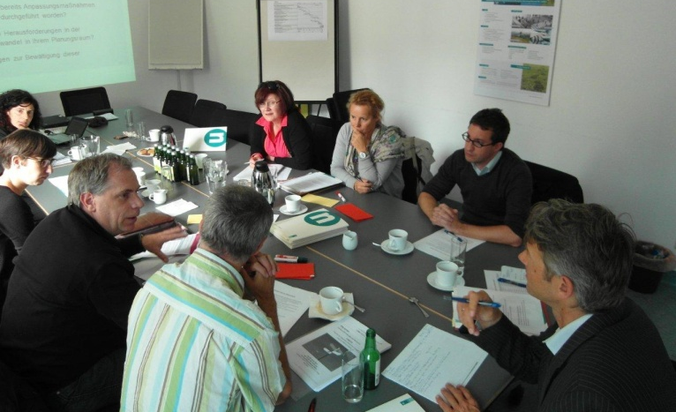
Learn from existing approaches
Analyse of 49 peer-reviewed articles on barriers in adaptation policy making → Classification of 16 barriers according the policy cycle
Screening of 32 guidelines for adaptation policy making → Findings on how barriers are addressed and what they suggest to overcome
Learn from case studies
Select two sectors and assess how they deal with climate change adaptation within their responsibilities → Tourism in Upper Austria and flood protection in the Waldviertel region
Assess case studies based on literature review and interviews → Results on current state of play in these two sectors and better understanding on multi-level governance in Austria
Existing work in this field
FAMOUS Handbook on adaptation
Input from advisory board
Core:
Involvement of potential users in the
development process (via 5 workshops,
written consultation process)
Available in English:http://www.klimawandelanpassung.at/ms/klimawandelanpassung/en/
Notes:
Slide and Post cards with link bzw. print example

Slide 43
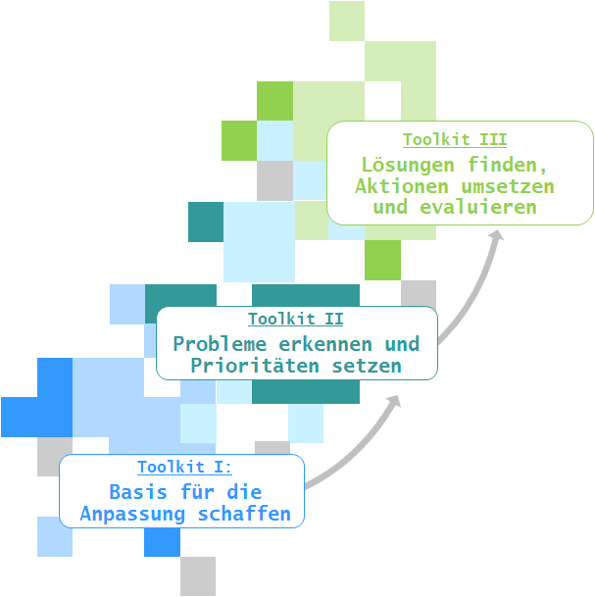
Handbook on adaptation
FAMOUS Handbook on adaptation
3 toolkits will address the steps of the policy cycle:
The “Create the ground for adaptation” toolkit aims to support the agenda setting stage of policy making
The “Identify problems and find solutions” toolkit is concerned with priorisation of main impacts, selection
of adaptation options, mainstreaming, preparing a strategy document, etc.
The “Implement actions and evaluate provides support in monitoring/evaluation, suggests communication formats, etc.
3. Implement actions and evaluate
2. Identify problems and find solutions
Create the ground for adaptation
Notes:
Outline of Handbook

Slide 44




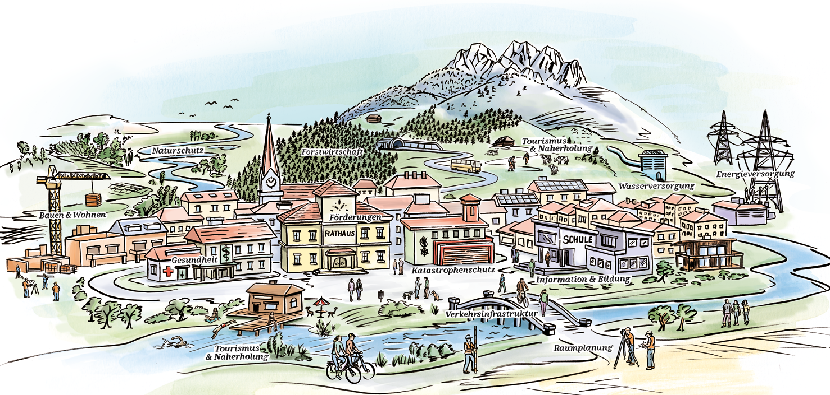
CC-ACT Online-tool for adaptation
    New regional adaptation programme (Climate- and Energyfund Austria) starting in September 2016
      Communities can apply for funds covering human resources to work on adaptation
Notes:
Handbook is not enough… other ways to address regional level.
Idea of CC-ACT is to use multipliers with well established links to municipalities and train them in order to be able to bring the adaptation message to the local level.
We are currently working on a training guide book for multipliers and also on a online tool they can use when advicing municipalities. Work in progress – but will be published only in German…

Slide 45
Experiences and reflections with focus on Implementation
    Cooperation-based, “soft” network mode of governance with predominantly voluntary instruments → works in relation to capacity building and awareness raising
    Ministry for Environment is not in the position to ask other Ministries or the provinces to implement adaptation measures recommended in the NAS/NAP → implementation of measures happen mainly on a voluntary base → other adaptation-relevant measures are undertaken by Ministries, but not necessarily under the heading of “adaptation” or in the context of the NAS/NAP → difficult to steer and coordinate the cross-cutting issue of adaptation
    Implementation plan between Federal Environmental Ministry and Provinces established to agree on a few specific measures to be implemented → for 2016 → working group on increased private initiative in case of extreme weather events and stronger joined efforts to support adaptation on regional level (i.e. with regional workshops, a brochure with best-practice)
    We may not forget: Adaptation is a (learning) process

Slide 46

Monitoring: Approach and Lessons learned
Notes:
Last part of my presentation is also usually the last stage of the policy process: Monitoring, evaluation and reporting. Evaluation is nevertheless an issue we have not started to address by now.

Slide 47

Monitoring → 1st Progress Report
Goals and purpose
To provide an overview on the implementation progress
of adaptation based on the Austrian NAS and NAP
To identify adaptation gaps and further
adaptation needs
To provide information on key trends of
impacts/vulnerabilities
To create a basis for revision of the strategy
To create added value for all concerned stakeholders
Source: de.123rf.com
Kick-off
Jan. 2013
Stakeholder Workshop
Sept. 2013
M framework
March 2014
Expert survey & workshop
Data gathering and analysis
Final Progress Report
October 2015

Slide 48
Development principles
Efficient system with limited efforts
Pragmatic approach
Easy-to-manage and multi-purpose
Use of existing data, no gathering of new quantitative data

Slide 49

Overall monitoring approach
Participatory approach
Self-assessment
Overall view
on the implementation of the NAS and the progress of adaptation
Twofold approach
Criteria catalogue
Data
based approach
The joint consideration of these two components can provide a broad picture of the implementation of the NAS/NAP and key adaptation trends in Austria.
NAP with 14 activity fields (sectors), goals and measures

Slide 50

Ad Self-Assessment
    What to monitor? – (Policy) implementation process; stage of implementation of the actions (132) of the NAP
    Who monitors? – relevant stakeholders from all 14 sectors (ministries, provinces, organized interest groups)
    How to monitor?
      Electronic questionnaire (Excel)
      Verbal rating scale per single measure
      with 5 grades

Slide 51
Ad Criteria catalogue
    What to monitor? – Responses (implementation of actions/measures); climate impacts (where data or knowledge about effects of climate change are missing)
    How to monitor?
      Set of criteria: 3-5 key criteria for each activity field (sector)= 45 criteria in total
      Mix of quantitative and qualitative criteria, incl. cross-cutting criteria
      Responding to adaptation goals of the activity fields
      Requirements (selection):
      - clearly relevant for adaptation, able to show adaptation trends
      - based on existing data sources (or collectable with little effort)
      - measurable on national level
      - data collection repeated on an appropriate timeframe
      - robust, statistically validated data
      - selected in agreement with experts

Slide 52








Results…

Slide 53
1st Progress report on Adaptation for Austria concludes…
    … measures recommended in the NAP have been or are being implemented in all activity fields
    … partly strong differences in progress between sectors
    … positive examples of sectors (e.g.):
      Forest management
      Water management
      Natural hazard management
      Agriculture
    → Substantial adaptation gaps still persist…

Slide 54
Experiences and reflections with focus on Monitoring
    Monitoring scheme development and implementation process was resource-intensive
    Not all aspects of adaptation processes are “measurable”
      Criteria often allow only partial or indirect statements
      Criteria allow different ways of interpretation => carefulness in interpretation of results
    Participation of stakeholders in concept development and via survey has contributed to awareness-raising, communication and coordination of NAS
    Highly useful information base for forthcoming 1st revision of NAS/NAP
    Still open how to do evaluation of adaptation policy → European wide an open and new issue

Slide 55

Adaptation journey continues…
Update and advancement of the NAS/NAP policy documents → 1st draft was send out for consultation in mid 2016
Integration of new research results (COIN, AAR2014, etc.) and from 1st progress report, recommendation of new adaptation measures

Slide 56
THANKS YOU!

Slide 57
Contact
Andrea Prutsch
P: +43 1 31304 3462
E-Mail: andrea.prutsch@umweltbundesamt.at
Umweltbundesamt
www.umweltbundesamt.at
Zagreb ■ 8 September 2016

